Slide 1
Graphical User Interfaces
JavaFX GUI Basics, Event Programming and GUI UI Controls

Slide 2
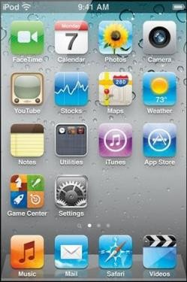
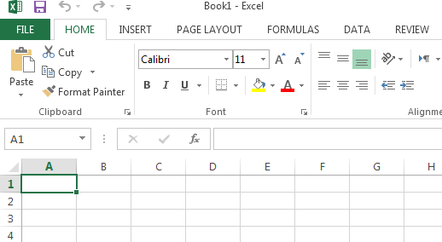
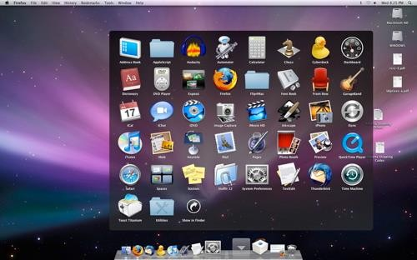
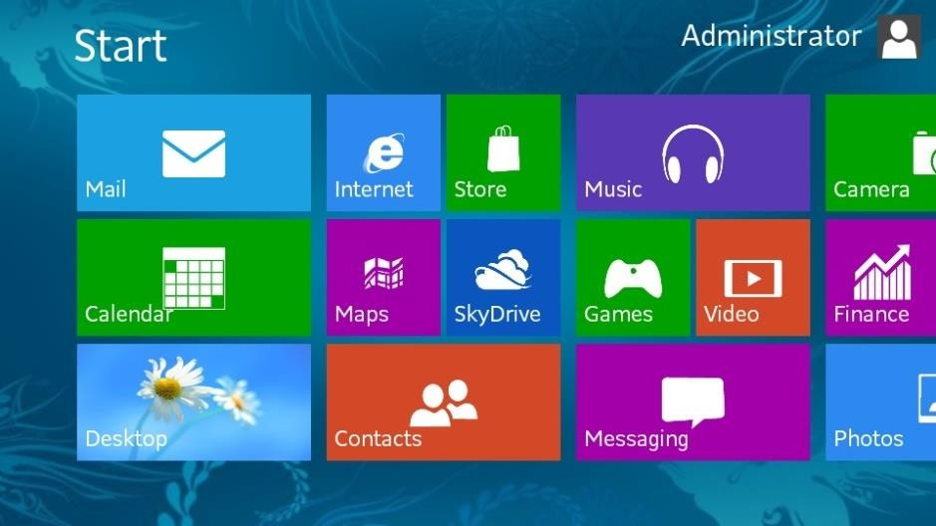
GUI Examples
2

Slide 3
GUI
Graphical User Interface (GUI)
provides user-friendly human interaction
Building Java GUIs require use of frameworks:
AWT
Swing
JavaFX (part of Java since JSE 8, 2014) includes:
GUI components
Event Programming
Graphics
3

Slide 4
How do GUIs work?
They loop and respond to events
Construct GUI Components
Render GUI
Check to see if any input
Respond to user input
4

Slide 5
Example: a mouse click on a button
Operating System recognizes mouse click
determines which window it was inside
notifies that program
Program runs in loop
checks input buffer filled by OS
if it finds a mouse click:
determines which component in the program
if the click was on a relevant component
respond appropriately according to handler
5

Slide 6
GUI Look vs. Behavior
Look
physical appearance
custom component design
containment
layout management
Behavior
interactivity
event programmed response
6

Slide 7
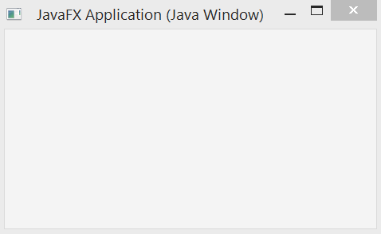
What does a GUI framework do for you?
Provides ready made visible, interactive, customizable components
you wouldn’t want to have to code your own
window
7

Slide 8
JavaFX vs Swing and AWT
Swing and AWT are replaced by the JavaFX platform for developing rich Internet applications in JDK8 (2014)
History:
When Java was introduced (1996), the GUI classes were bundled in a library known as the Abstract Windows Toolkit (AWT)
AWT was prone to platform-specific bugs
AWT was fine for developing simple graphical user interfaces, but not for developing comprehensive GUI projects
The AWT user-interface components were replaced by a more robust, versatile, and flexible library known as Swing components (1997)
Swing components are painted directly on canvases using Java code
Swing components depend less on the target platform and use less of the native
GUI resource
With the release of Java 8, Swing is replaced by a completely new GUI platform: JavaFX
8

Slide 9
Basic Structure of JavaFX
Stage Scene
Button
javafx.application.Application is the entry point for JavaFX applications
JavaFX creates an application thread for running the application start method, processing input events, and running animation timelines.
Override the start(Stage) method!
javafx.stage.Stage is the top level JavaFX container.
The primary Stage is constructed by the platform.
javafx.scene.Scene class is the container for all content in a scene graph.
javafx.scene.Node is the base class for
scene graph nodes.
9

Slide 10
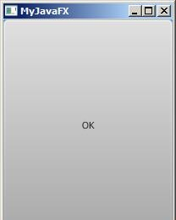
import javafx.application.Application; import javafx.stage.Stage;
import javafx.scene.Scene;
import javafx.scene.control.Button;
public class MyFirstJavaFX extends Application {
@Override // Override the start method in the Application class public void start(Stage primaryStage) {
// Create a button and place it in the scene
Button btOK = new Button("OK");
Scene scene = new Scene(btOK, 200, 250); primaryStage.setTitle("MyJavaFX"); // Set the stage title primaryStage.setScene(scene); // Place the scene in the stage primaryStage.show(); // Display the stage
}
/**
The main method is only needed for the IDE with limited
JavaFX support. Not needed for running from the command line.
*/
public static void main(String[] args) { launch(args);
}
}

Slide 11
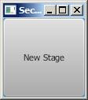
// Multiple stages can be added beside the primaryStage import javafx.application.Application;
import javafx.stage.Stage; import javafx.scene.Scene;
import javafx.scene.control.Button;
public class MultipleStageDemo extends Application {
@Override // Override the start method in the Application class public void start(Stage primaryStage) {
// Create a scene and place a button in the scene Scene scene = new Scene(new Button("OK"), 200, 250);
primaryStage.setTitle("MyJavaFX"); // Set the stage title primaryStage.setScene(scene); // Place the scene in the stage primaryStage.show(); // Display the stage
Stage stage = new Stage(); // Create a new stage stage.setTitle("Second Stage"); // Set the stage title
// Set a scene with a button in the stage
stage.setScene(new Scene(new Button("New Stage"), 100, 100)); stage.show(); // Display the stage
}
public static void main(String[] args) { launch(args);
}
}

Slide 12
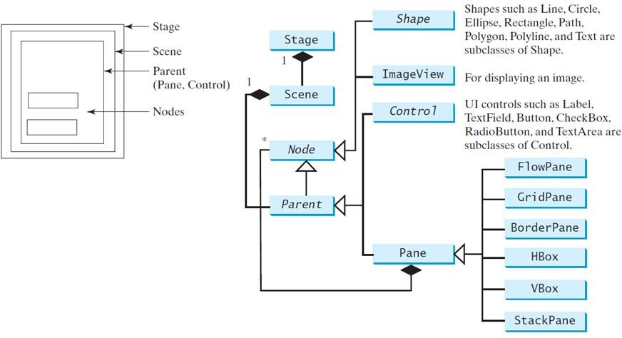
Panes, UI Controls, and Shapes

Slide 13
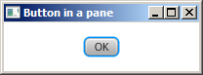
import javafx.application.Application; import javafx.stage.Stage;
import javafx.scene.Scene;
import javafx.scene.layout.StackPane; import javafx.scene.control.Button;
public class ButtonInPane extends Application {
@Override // Override the start method in the Application class public void start(Stage primaryStage) {
// Create a scene and place a button in the scene StackPane pane = new StackPane(); pane.getChildren().add(new Button("OK"));
Scene scene = new Scene(pane, 200, 50); primaryStage.setTitle("Button in a pane"); // Set the stage title primaryStage.setScene(scene); // Place the scene in the stage primaryStage.show(); // Display the stage
}
public static void main(String[] args) { launch(args);
}
}

Slide 14
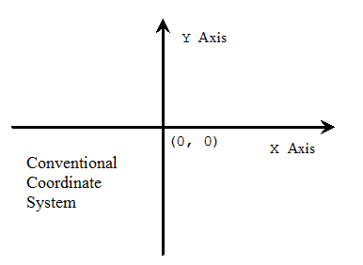
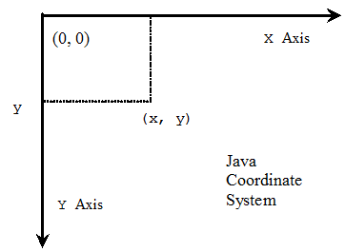
Display a Shape
Programming Coordinate Systems start from the left-upper corner

Slide 15
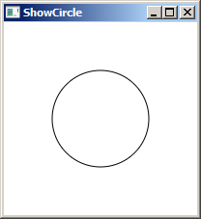
Circle in a Pane
import javafx.application.Application; import javafx.stage.Stage;
import javafx.scene.Scene; import javafx.scene.layout.Pane;
import javafx.scene.shape.Circle;
import javafx.scene.paint.Color;
public class ShowCircle extends Application {
@Override // Override the start method in the Application class public void start(Stage primaryStage) {
// Create a circle and set its properties Circle circle = new Circle(); circle.setCenterX(100); circle.setCenterY(100); circle.setRadius(50); circle.setStroke(Color.BLACK); circle.setFill(null);
// Create a pane to hold the circle Pane pane = new Pane(); pane.getChildren().add(circle);
// Create a scene and place it in the stage Scene scene = new Scene(pane, 200, 200);
primaryStage.setTitle("ShowCircle"); // Set the stage title primaryStage.setScene(scene); // Place the scene in the stage primaryStage.show(); // Display the stage
}
/**
The main method is only needed for the IDE with limited
JavaFX support. Not needed for running from the command line.
*/
public static void main(String[] args) {
launch(args);
}
}15

Slide 16
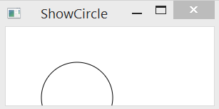
Binding Properties
JavaFX introduces a new concept called binding property
that enables a target object to be bound to a source object.
If the value in the source object changes, the target property is also changed automatically.
The target object is simply called a binding object or a binding property.
Resizing the window in the previous example would cover the object:
16

Slide 17
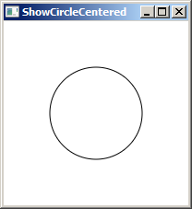
import javafx.application.Application; import javafx.stage.Stage;
import javafx.scene.Scene; import javafx.scene.layout.Pane;
import javafx.scene.shape.Circle;
import javafx.scene.paint.Color;
public class ShowCircleCentered extends Application { @Override // Override the start method in the Application class public void start(Stage primaryStage) {
// Create a pane to hold the circle Pane pane = new Pane();
// Create a circle and set its properties Circle circle = new Circle();
circle.centerXProperty().bind(pane.widthProperty().divide(2)); circle.centerYProperty().bind(pane.heightProperty().divide(2));
circle.setRadius(50); circle.setStroke(Color.BLACK); circle.setFill(Color.WHITE);
pane.getChildren().add(circle); // Add circle to the pane
// Create a scene and place it in the stage Scene scene = new Scene(pane, 200, 200);
primaryStage.setTitle("ShowCircleCentered"); // Set the stage title primaryStage.setScene(scene); // Place the scene in the stage primaryStage.show(); // Display the stage
}
/**
The main method is only needed for the IDE with limited
JavaFX support. Not needed for running from the command line.
*/
public static void main(String[] args) { launch(args);
17
}
}
(c) Paul Fodor and Pearson Inc.

Slide 18
JavaFX Beans and Binding
Changes made to one object will automatically be reflected in another object
A graphical user interface automatically keeps its display synchronized with the application's underlying data: a binding observes its list of dependencies for changes, and then updates itself automatically after a change has been detected.
import javafx.beans.property.DoubleProperty; import javafx.beans.property.SimpleDoubleProperty;
public class BindingDemo {
public static void main(String[] args) { DoubleProperty d1 = new SimpleDoubleProperty(1); DoubleProperty d2 = new SimpleDoubleProperty(2); d1.bind(d2);
System.out.println("d1 is " + d1.getValue()
+ " and d2 is " + d2.getValue());
Output:
d1 is 2.0 and d2 is 2.0
d2.setValue(70.2);
System.out.println("d1 is " + d1.getValue()
+ " and d2 is " + d2.getValue());
(c) Paul Fodor and Pearson Inc.
d1 is 70.2 and d2 is 70.2
18}
}

Slide 19
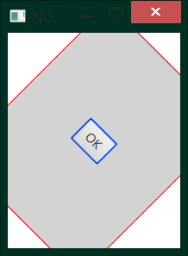
JavaFX CSS style and Node rotation
import javafx.application.Application; import javafx.stage.Stage;
import javafx.scene.Scene;
import javafx.scene.layout.StackPane; import javafx.scene.control.Button;
public class NodeStyleRotateDemo extends Application { @Override
public void start(Stage primaryStage) { StackPane pane = new StackPane(); Button btOK = new Button("OK");
btOK.setStyle("-fx-border-color: blue;"); pane.getChildren().add(btOK); pane.setRotate(45);
pane.setStyle("-fx-border-color: red; -fx-background-color: lightgray;"); Scene scene = new Scene(pane, 200, 250); primaryStage.setTitle("NodeStyleRotateDemo"); // Set the stage title primaryStage.setScene(scene); // Place the scene in the stage primaryStage.show(); // Display the stage
}
/**
* The main method | is only needed | for the IDE with | limited
* JavaFX support. | Not needed for | running from the | command line.
*/
public static void main(String[] args) {
launch(args);
19
}
}
(c) Paul Fodor and Pearson Inc.

Slide 20
JavaFX CSS style and Node rotation
import javafx.application.Application; import javafx.stage.Stage;
import javafx.scene.Scene;
import javafx.scene.layout.StackPane; import javafx.scene.control.Button;
public class NodeStyleRotateDemo extends Application { @Override
public void start(Stage primaryStage) {
StackPane pane = new StackPane();
/* The StackPane layout pane places all of the nodes within a single stack with each new node added on top of the previous node. This layout model provides an easy way to overlay text on a shape or image and to overlap common shapes to create a complex shape. */
20
(c) Paul Fodor and Pearson Inc.

Slide 21
JavaFX External CSS style file
// Example to load and use a CSS style file in a scene import javafx.application.Application;
import javafx.stage.Stage;
import javafx.scene.Scene;
import javafx.scene.layout.BorderPane;
public class ExternalCSSFile extends Application {
@Override
public void start(Stage primaryStage) { try {
BorderPane root = new BorderPane(); Scene scene = new Scene(root,400,400); scene.getStylesheets().add(getClass()
.getResource("application.css").toExternalForm()); primaryStage.setScene(scene);
primaryStage.show();
} catch(Exception e) {
e.printStackTrace();
}
}
public static void main(String[] args) { launch(args);
}
21 }
(c) Paul Fodor and Pearson Inc.

Slide 22
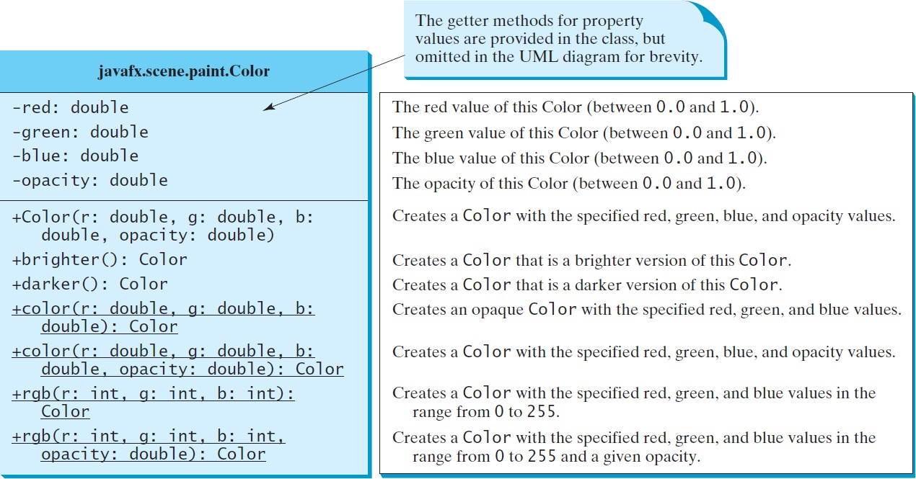
Helper classes: The Color Class

Slide 23
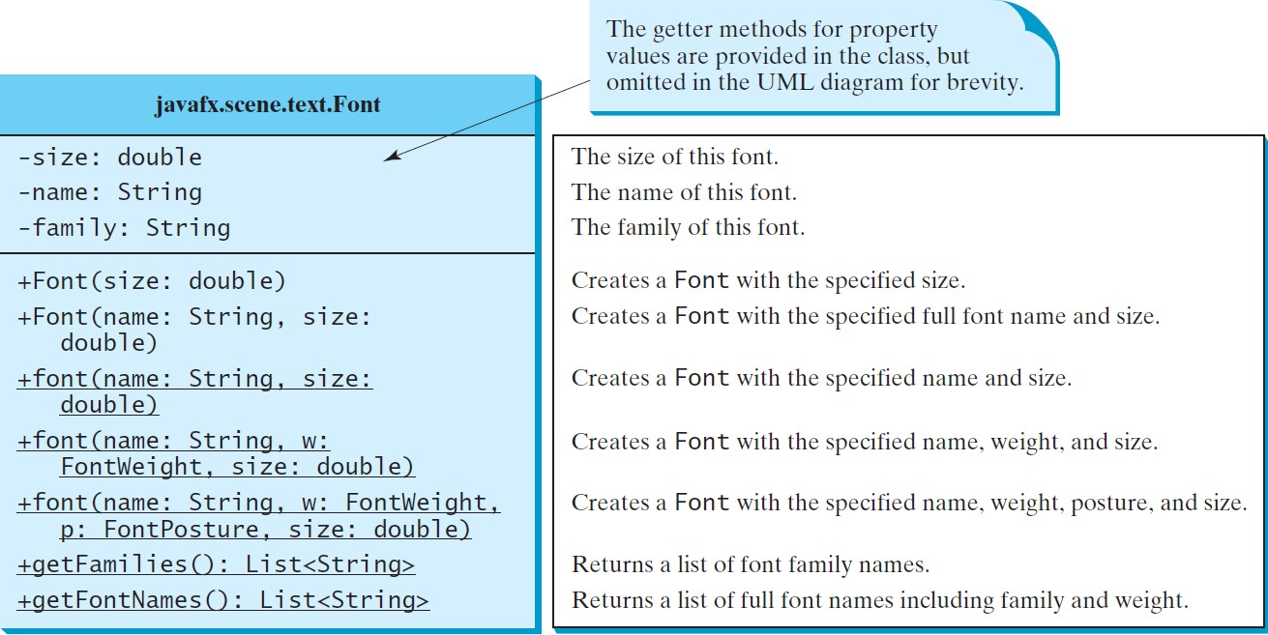
Helper classes: The Font Class

Slide 24
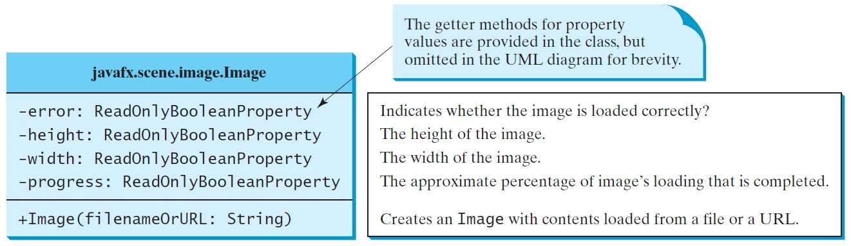
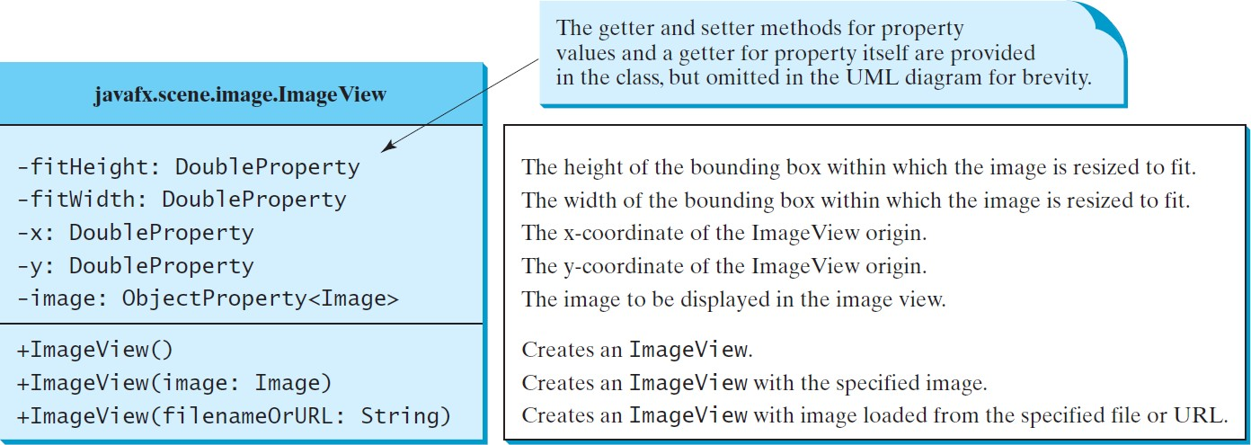
The Image and ImageView Classes

Slide 25

import javafx.application.Application; import javafx.stage.Stage;
import javafx.scene.Scene; import javafx.scene.layout.Pane; import javafx.scene.layout.HBox; import javafx.scene.image.Image;
import javafx.scene.image.ImageView; import javafx.geometry.Insets;
public class ShowImage extends Application {
@Override
public void start(Stage primaryStage) {
// Create a pane to hold the image views Pane pane = new HBox(10); pane.setPadding(new Insets(5, 5, 5, 5)); Image image = new Image("paul.jpg");
pane.getChildren().add(new ImageView(image)); ImageView imageView2 = new ImageView(image); imageView2.setFitHeight(100); imageView2.setFitWidth(100); imageView2.setRotate(90); pane.getChildren().add(imageView2);
Scene scene = new Scene(pane); primaryStage.setTitle("ShowImage"); primaryStage.setScene(scene); primaryStage.show();
}
public static void main(String[] args) {
launch(args);
}
25
}
(c) Paul Fodor and Pearson Inc.

Slide 26
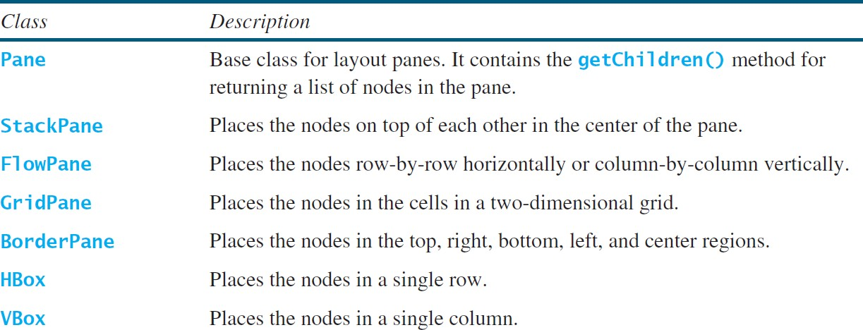
Layout Panes
JavaFX provides many types of panes for organizing nodes in a container.

Slide 27
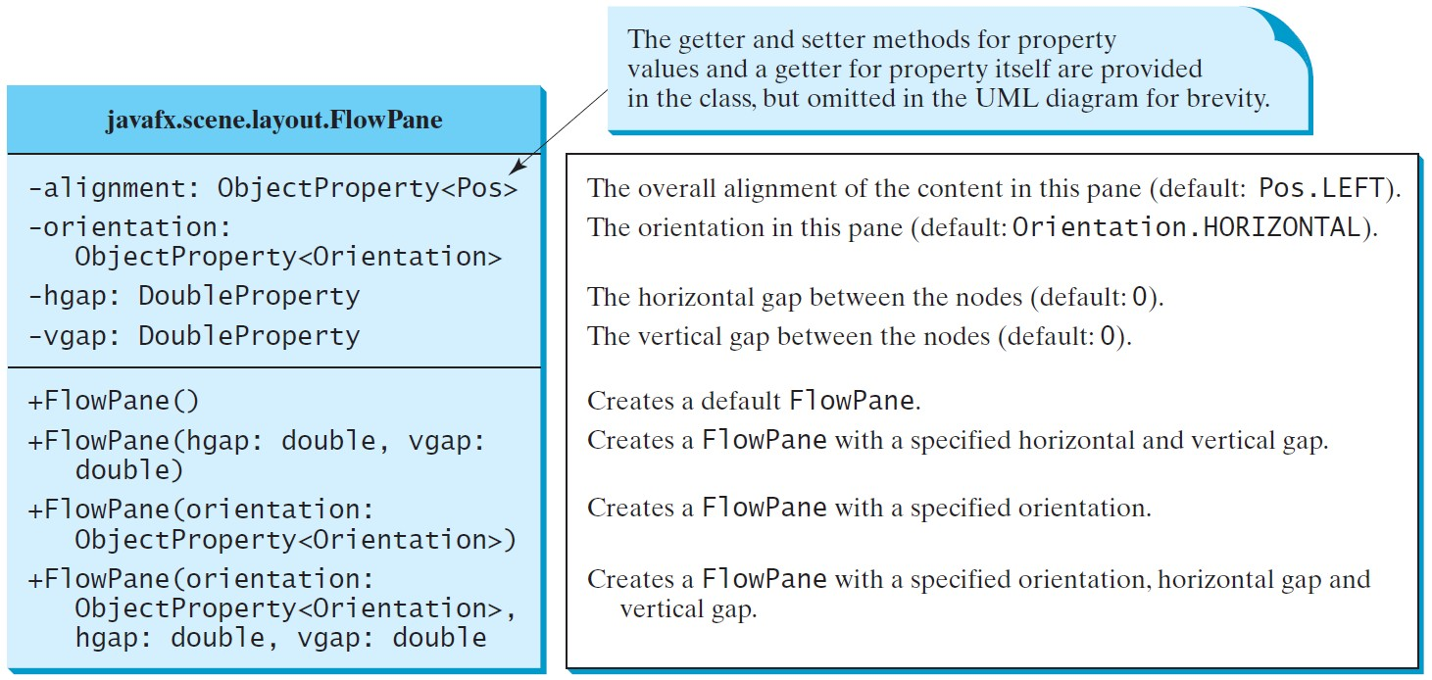
FlowPane

Slide 28
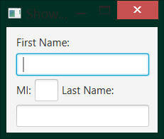
import javafx.application.Application; import javafx.stage.Stage;
import javafx.scene.Scene;
import javafx.scene.layout.FlowPane; import javafx.scene.control.Label; import javafx.scene.control.TextField; import javafx.geometry.Insets;
public class ShowFlowPane extends Application { @Override
public void start(Stage primaryStage) { FlowPane pane = new FlowPane(); pane.setPadding(new Insets(11, 12, 13, 14)); pane.setHgap(5);
pane.setVgap(5);
// Place nodes in the pane pane.getChildren().addAll(new Label("First Name:"),
new TextField(), new Label("MI:")); TextField tfMi = new TextField(); tfMi.setPrefColumnCount(1);
pane.getChildren().addAll(tfMi, new Label("Last Name:"), new TextField());
// Create a scene and place it in the stage Scene scene = new Scene(pane, 210, 150); primaryStage.setTitle("ShowFlowPane");
primaryStage.setScene(scene); // Place the scene in the stage primaryStage.show(); // Display the stage
}
public static void main(String[] args) {
launch(args);
}
28
}
(c) Paul Fodor and Pearson Inc.

Slide 29
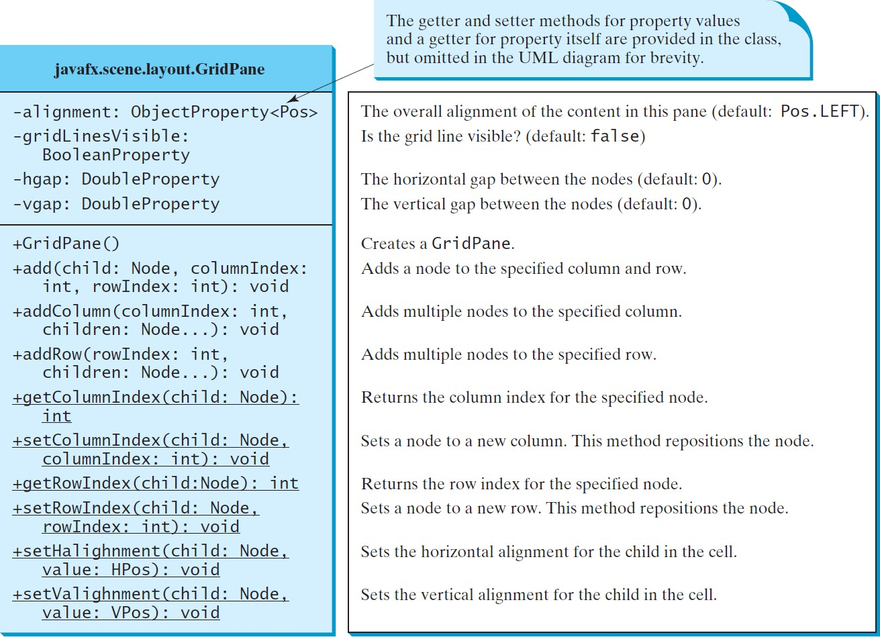
GridPane
29
(c) Paul Fodor and Pearson Inc.

Slide 30
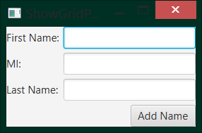
import javafx.application.Application; import javafx.stage.Stage;
import javafx.scene.Scene;
import javafx.scene.layout.GridPane; import javafx.scene.control.*; import javafx.geometry.*;
public class ShowGridPane extends Application { @Override
public void start(Stage primaryStage) {
// Create a pane and set its properties GridPane pane = new GridPane(); pane.setAlignment(Pos.CENTER); pane.setHgap(5.5);
pane.setVgap(5.5);
// Place nodes in the pane at positions pane.add(new Label("First Name:"), 0, 0);
pane.add(new TextField(), 1, 0);
pane.add(new Label("MI:"), 0, 1);
pane.add(new TextField(), 1, 1);
pane.add(new Label("Last Name:"), 0, 2);
pane.add(new TextField(), 1, 2); Button btAdd = new Button("Add Name"); pane.add(btAdd, 1, 3);
column,row
GridPane.setHalignment(btAdd, HPos.RIGHT);
// Create a scene and place it in the stage Scene scene = new Scene(pane); primaryStage.setTitle("ShowGridPane");
primaryStage.setScene(scene); primaryStage.show(); }
public static void main(String[] args) { launch(args);
30
}}
(c) Paul Fodor and Pearson Inc.

Slide 31
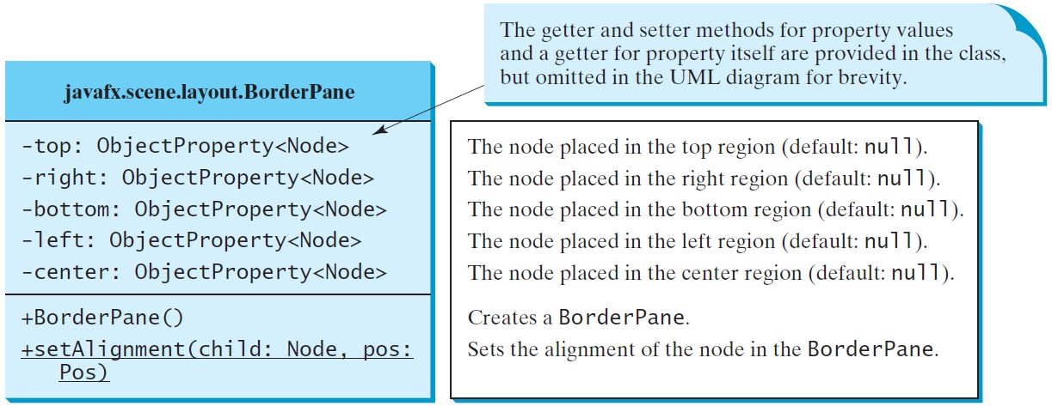
BorderPane
31

Slide 32
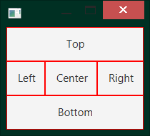
import javafx.application.Application; import javafx.stage.Stage;
import javafx.scene.Scene;
import javafx.scene.layout.BorderPane; import javafx.scene.layout.StackPane; import javafx.scene.control.Label; import javafx.geometry.Insets;
public class ShowBorderPane extends Application { @Override
public void start(Stage primaryStage) { BorderPane pane = new BorderPane(); pane.setTop(new CustomPane("Top")); pane.setRight(new CustomPane("Right")); pane.setBottom(new CustomPane("Bottom")); pane.setLeft(new CustomPane("Left")); pane.setCenter(new CustomPane("Center")); Scene scene = new Scene(pane);
primaryStage.setScene(scene); primaryStage.show();
}
public static void main(String[] args) { launch(args);
}
}
class CustomPane extends StackPane { public CustomPane(String title) {
getChildren().add(new Label(title)); setStyle("-fx-border-color: red");
setPadding(new Insets(11.5, 12.5, 13.5, 14.5));
}
}
32

Slide 33
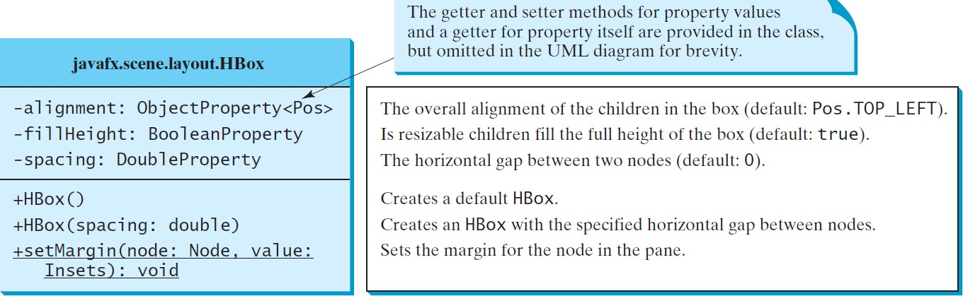
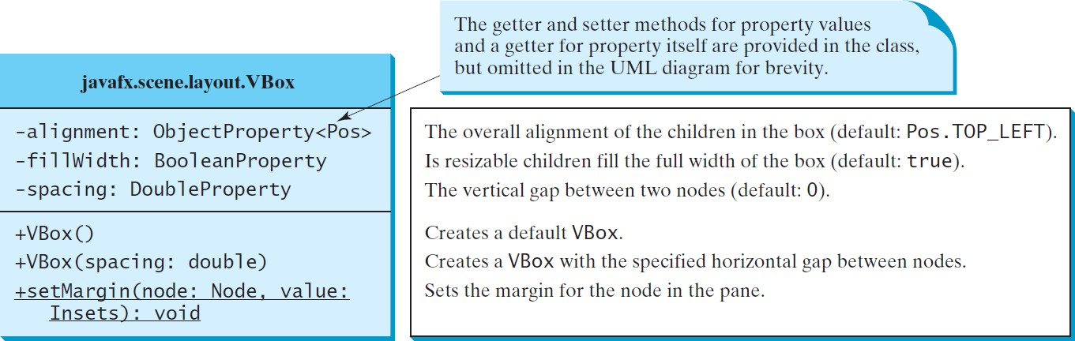
Hbox and VBox
33
(c) Paul Fodor and Pearson Inc.

Slide 34
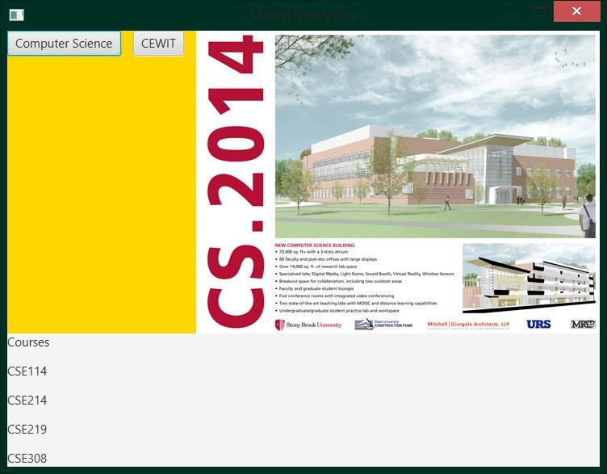
import javafx.application.Application; import javafx.stage.Stage;
import javafx.scene.Scene;
import javafx.scene.layout.BorderPane; import javafx.scene.layout.HBox; import javafx.scene.layout.VBox; import javafx.scene.control.Button; import javafx.scene.control.Label; import javafx.scene.image.Image; import javafx.scene.image.ImageView;
public class ShowHBoxVBox extends Application { @Override
public void start(Stage primaryStage) { BorderPane pane = new BorderPane(); HBox hBox = new HBox(15);
hBox.setStyle("-fx-background-color: gold"); hBox.getChildren().add(new Button("Computer Science")); hBox.getChildren().add(new Button("CEWIT"));
ImageView imageView = new ImageView(new Image("cs14.jpg"));
hBox.getChildren().add(imageView);
pane.setTop(hBox);
VBox vBox = new VBox(15); vBox.getChildren().add(new Label("Courses"));
Label[] courses = {new Label("CSE114"), new Label("CSE214"), new Label("CSE219"), new Label("CSE308")};
for (Label course: courses) {
vBox.getChildren().add(course);
}
pane.setLeft(vBox);
Scene scene = new Scene(pane); primaryStage.setScene(scene);
34
primaryStage.show();
(c) Paul Fodor and Pearson Inc.
}

Slide 35
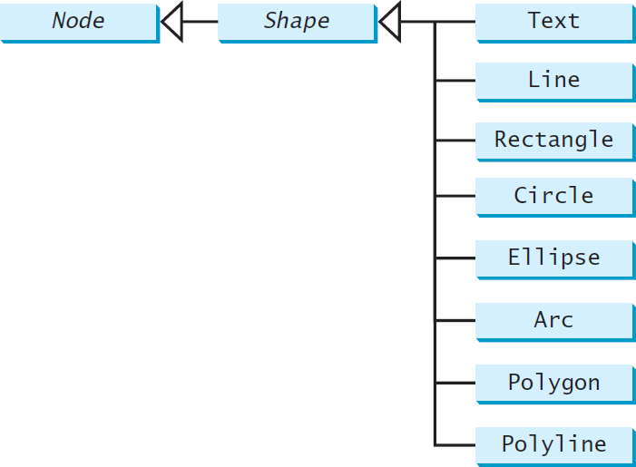
Shapes
JavaFX provides many shape classes for drawing texts, lines, circles, rectangles, ellipses, arcs, polygons, and polylines.
35
(c) Paul Fodor and Pearson Inc.

Slide 36
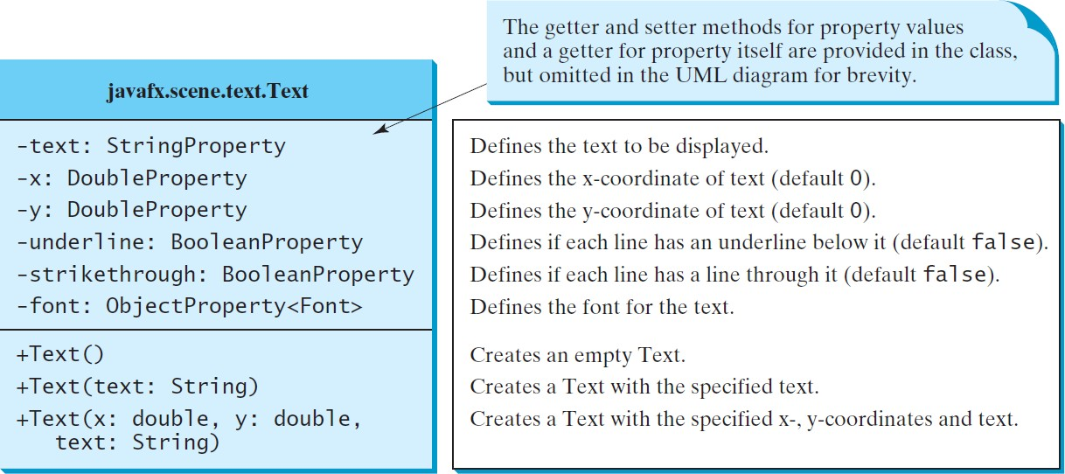
Text
36

Slide 37
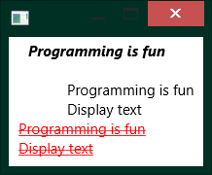
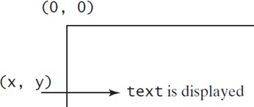
import javafx.application.Application; import javafx.stage.Stage;
import javafx.scene.Scene; import javafx.scene.layout.Pane; import javafx.scene.paint.Color; import javafx.geometry.Insets; import javafx.scene.text.Text; import javafx.scene.text.Font;
import javafx.scene.text.FontWeight; import javafx.scene.text.FontPosture; public class ShowText extends Application {
@Override
public void start(Stage primaryStage) { Pane pane = new Pane(); pane.setPadding(new Insets(5, 5, 5, 5));
Text text1 = new Text(20, 20, "Programming is fun"); text1.setFont(Font.font("Courier", FontWeight.BOLD,
FontPosture.ITALIC, 15)); pane.getChildren().add(text1);
Text text2 = new Text(60, 60, "Programming is fun\nDisplay text");
pane.getChildren().add(text2);
Text text3 = new Text(10, 100, "Programming is fun\nDisplay text"); text3.setFill(Color.RED);
text3.setUnderline(true); text3.setStrikethrough(true); pane.getChildren().add(text3);
Scene scene = new Scene(pane, 600, 800); primaryStage.setScene(scene); primaryStage.show();
}
...
37
}
(c) Paul Fodor and Pearson Inc.

Slide 38
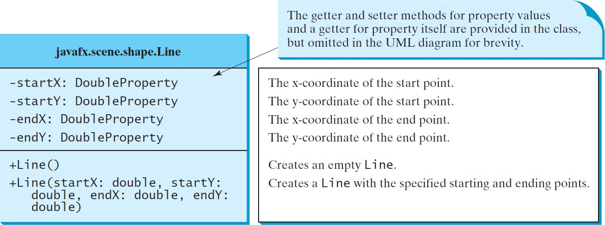
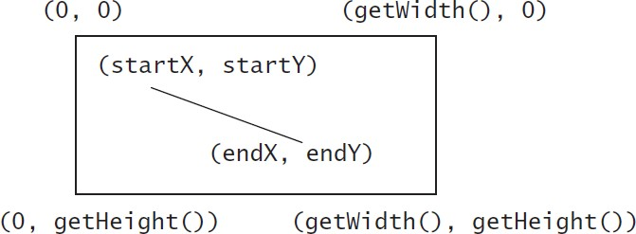
Line
38

Slide 39

import javafx.application.Application; import javafx.stage.Stage;
import javafx.scene.Scene; import javafx.scene.layout.Pane; import javafx.scene.shape.Line; import javafx.scene.paint.Color;
public class ShowLine extends Application { @Override
public void start(Stage primaryStage) {
Pane pane = new Pane();
Line line1 = new Line(10, 10, 10, 10); line1.endXProperty().bind(pane.widthProperty().subtract(10)); line1.endYProperty().bind(pane.heightProperty().subtract(10)); line1.setStrokeWidth(5);
line1.setStroke(Color.GREEN); pane.getChildren().add(line1);
Line line2 = new Line(10, 10, 10, 10); line2.startXProperty().bind(pane.widthProperty().subtract(10)); line2.endYProperty().bind(pane.heightProperty().subtract(10)); line2.setStrokeWidth(5);
line2.setStroke(Color.GREEN); pane.getChildren().add(line2);
Scene scene = new Scene(pane, 200, 200); primaryStage.setScene(scene); primaryStage.show();
}
public static void main(String[] args) { launch(args);
}
}
39

Slide 40
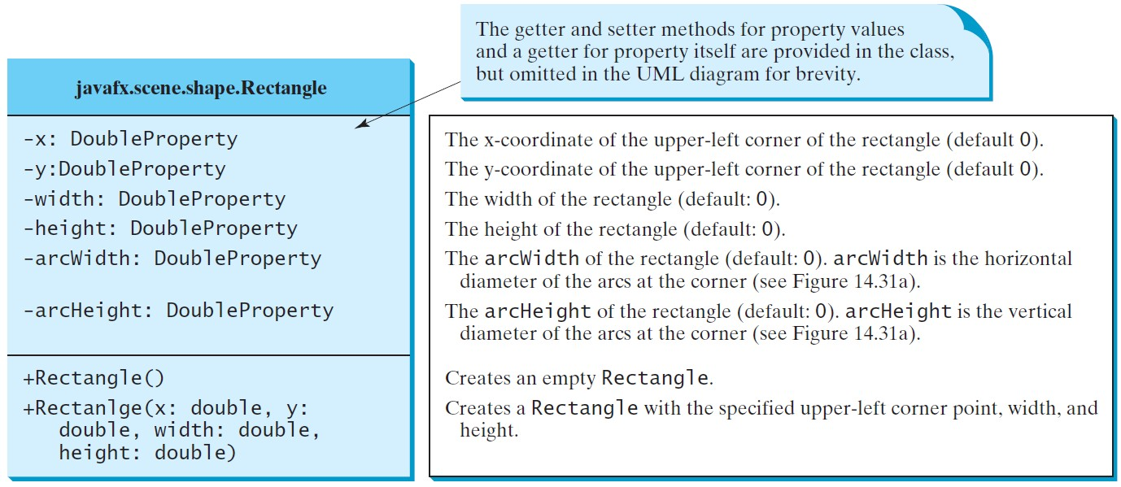
Rectangle
40

Slide 41
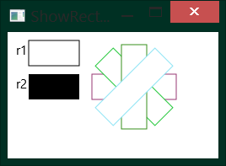
import javafx.application.Application; import javafx.stage.Stage;
import javafx.scene.Scene; import javafx.scene.layout.Pane; import javafx.scene.text.Text;
import javafx.scene.shape.Rectangle; import javafx.scene.paint.Color; import java.util.Collections;
public class ShowRectangle extends Application {
public void start(Stage primaryStage) { Pane pane = new Pane();
Rectangle r1 = new Rectangle(25, 10, 60, 30); r1.setStroke(Color.BLACK); r1.setFill(Color.WHITE); pane.getChildren().add(new Text(10, 27, "r1")); pane.getChildren().add(r1);
Rectangle r2 = new Rectangle(25, 50, 60, 30); pane.getChildren().add(new Text(10, 67, "r2")); pane.getChildren().add(r2);
for (int i = 0; i < 4; i++) {
Rectangle r = new Rectangle(100, 50, 100, 30);
r.setRotate(i * 360 / 8); r.setStroke(Color.color(Math.random(), Math.random(),
Math.random())); r.setFill(Color.WHITE); pane.getChildren().add(r);
}
Scene scene = new Scene(pane, 250, 150); primaryStage.setScene(scene); primaryStage.show();
}
41
...// main
(c) Paul Fodor and Pearson Inc.

Slide 42
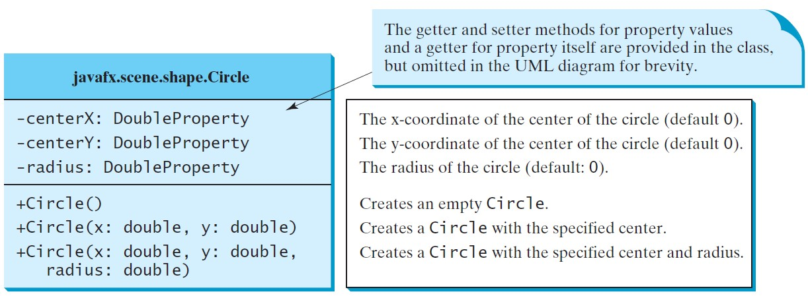
Circle
42

Slide 43
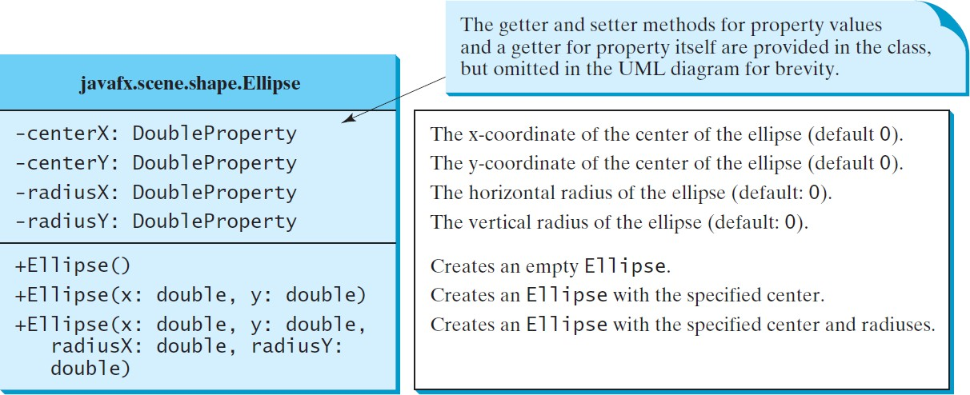
Ellipse
radiusX
radiusY
(centerX, centerY)
43

Slide 44
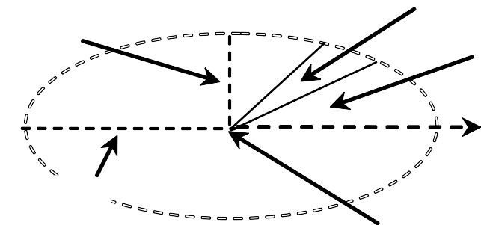
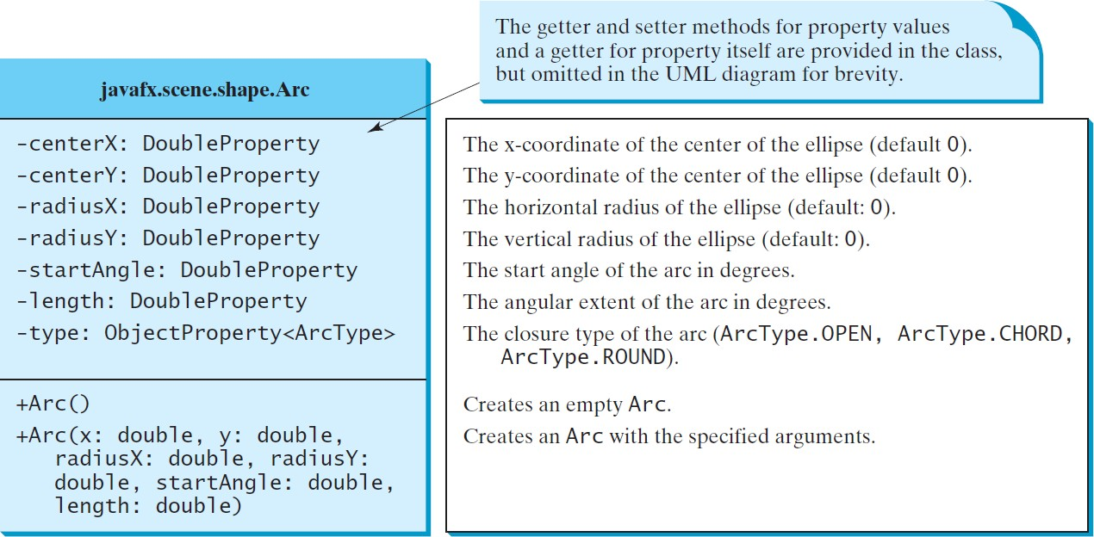
Arc
radiusY
length
startAngle
0 degree
radiusX
(centerX, centerY)
44

Slide 45
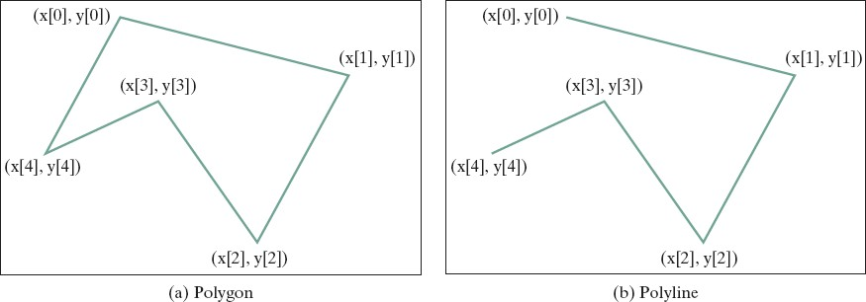
Polygon and Polyline
The getter and setter methods for property values and a getter for property itself are provided in the class, but omitted in the UML diagram for brevity.
javafx.scene.shape.Polygon
+Polygon()
+Polygon(double... points)
+getPoints(): ObservableList<Double>
Creates an empty polygon.
Creates a polygon with the given points.
Returns a list of double values as x- and y-coordinates of the points.
45

Slide 46
Event Programming
Procedural programming is executed in procedural/statement order
In event-driven programming, code is executed upon activation of events
Operating Systems constantly monitor events
Ex: keystrokes, mouse clicks, etc…
The OS:
sorts out these events
reports them to the appropriate programs
46

Slide 47
Where do we come in?
For each control (button, combo box, etc.):
define an event handler
construct an instance of event handler
tell the control who its event handler is
Event Handler?
code with response to event
a.k.a. event listener
47

Slide 48
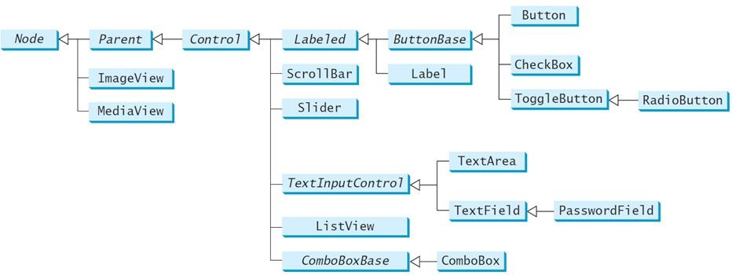
Java’s Event Handling
An event source is a GUI control
JavaFX: Button, ChoiceBox, ListView, etc.
http://docs.oracle.com/javase/8/javafx/user-interface-tutorial/ui_controls.htm
different types of sources:
can detect different types of events
can register different types of listeners (handlers)
48

Slide 49
Java’s Event Handling
When the user interacts with a control (source):
an event object is constructed
the event object is sent to all registered listener objects
the listener object (handler) responds as you defined it to
49

Slide 50
Event Listeners (Event Handler)
Defined by you, the application programmer
you customize the response
How?
Inheritance & Polymorphism
You define your own listener class
implement the appropriate interface
define responses in all necessary methods
50

Slide 51
Event Objects
Contain information about the event
Like what?
location of mouse click
event source that was interacted with
etc.
Listeners use them to properly respond
different methods inside a listener object can react differently to different types of interactions
51

Slide 52
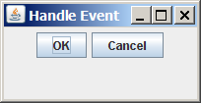
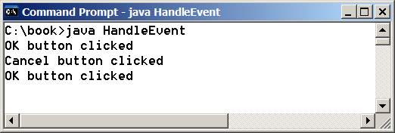
import javafx.application.Application; import javafx.stage.Stage;
import javafx.scene.Scene; import javafx.scene.layout.HBox;
import javafx.scene.control.Button; import javafx.event.ActionEvent; import javafx.event.EventHandler; import javafx.geometry.Pos;
public class HandleEvent extends Application { public void start(Stage primaryStage) {
HBox pane = new HBox(10); Button btOK = new Button("OK");
Button btCancel = new Button("Cancel"); OKHandlerClass handler1 = new OKHandlerClass(); btOK.setOnAction(handler1);
CancelHandlerClass handler2 = new CancelHandlerClass(); btCancel.setOnAction(handler2); pane.getChildren().addAll(btOK, btCancel);
Scene scene = new Scene(pane); primaryStage.setScene(scene); primaryStage.show();
}…/*main*/}
class OKHandlerClass implements EventHandler<ActionEvent> {
@Override
public void handle(ActionEvent e) { System.out.println("OK button clicked");
}}
class CancelHandlerClass implements EventHandler<ActionEvent> {
@Override
public void handle(ActionEvent e) {
52
System.out.println("Canc₍e_{c)}l_{Pau}b_{l} u_{Fo}t_{d}t_{or}o_{a}n_{nd P}c_{e}l_{ar}i_{so}c_{n}k_{In}e_{c}d. ");
}}

Slide 53
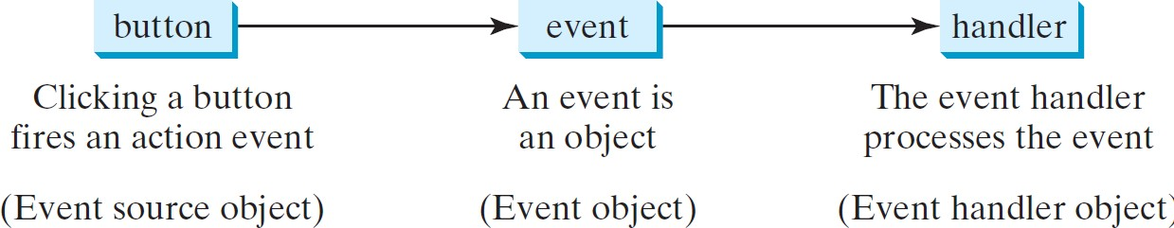
Handling GUI Events
Source object: button.
An event is generated by external user actions such as mouse movements, mouse clicks, or keystrokes.
An event can be defined as a type of signal to the program that something has happened.
Listener object contains a method for processing the event.

Slide 54
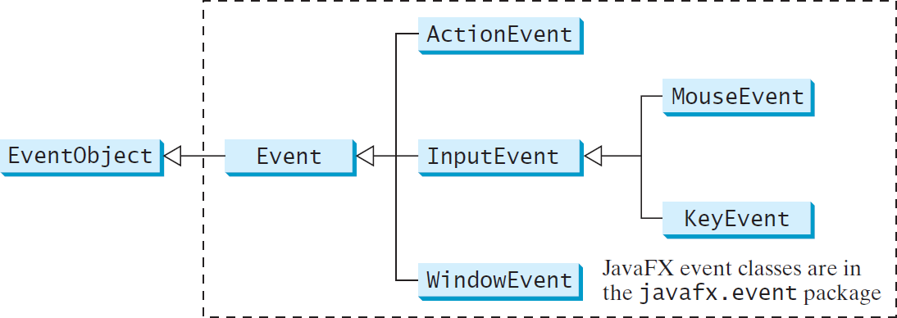
Event Classes

Slide 55
Event Information
An event object contains whatever properties are pertinent to the event:
the source object of the event using the getSource() instance method in the EventObject class.
The subclasses of EventObject deal with special types of events, such as button actions, window events, component events, mouse movements, and keystrokes.

Slide 56
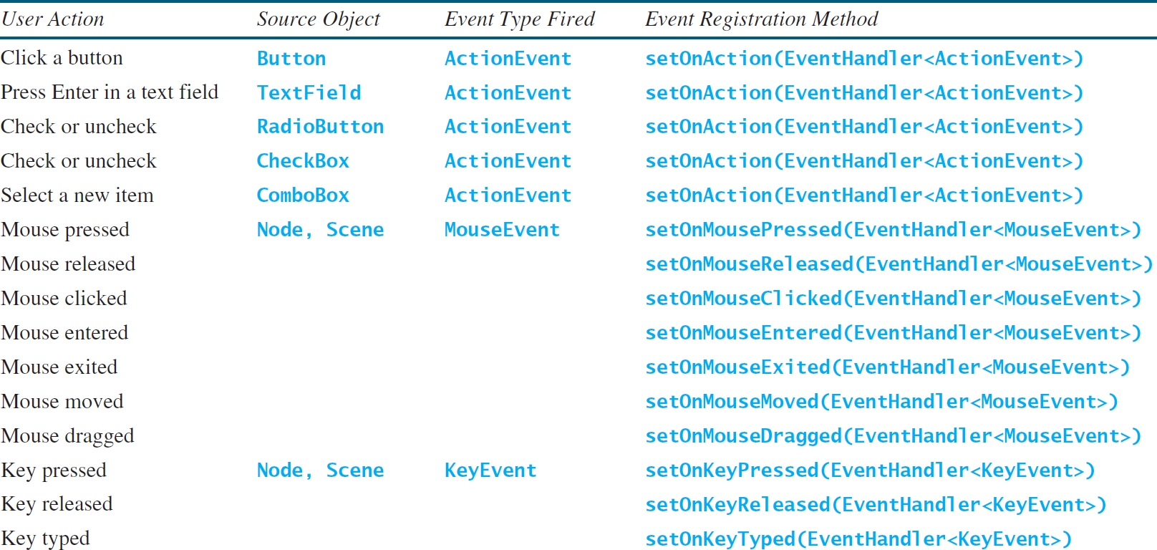
Selected User Actions and Handlers

Slide 57
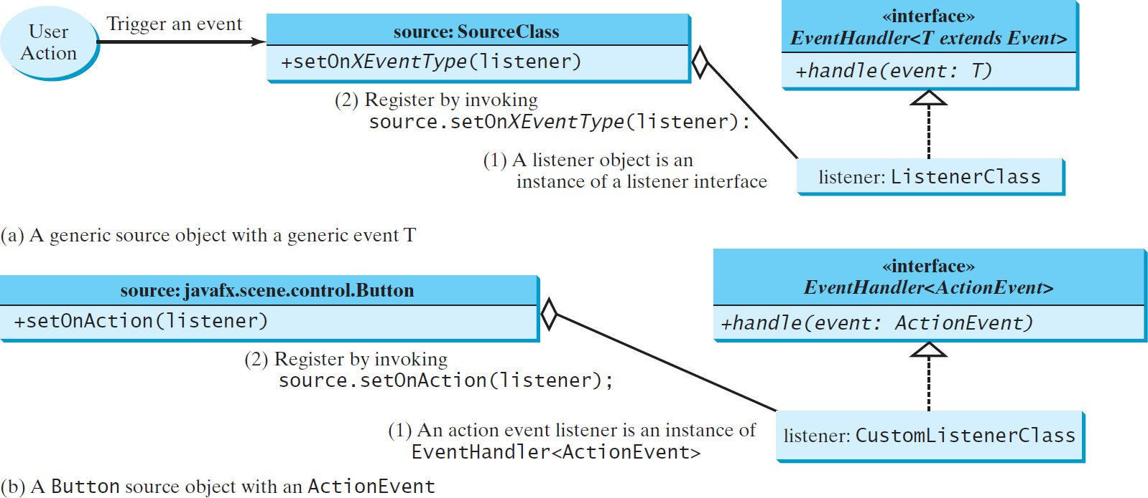
The Delegation Model

Slide 58
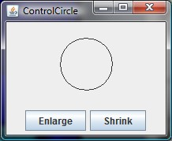

ControlCircle program that uses two buttons to control the size of a circle
import javafx.application.Application; import javafx.stage.Stage;
import javafx.scene.Scene;
import javafx.scene.layout.BorderPane; import javafx.scene.layout.HBox; import javafx.scene.layout.StackPane; import javafx.scene.control.Button; import javafx.event.ActionEvent; import javafx.event.EventHandler; import javafx.geometry.Pos;
import javafx.scene.paint.Color; import javafx.scene.shape.Circle;
public class ControlCircle extends Application { private CirclePane circlePane = new CirclePane(); @Override
public void start(Stage primaryStage) {
HBox hBox = new HBox();
Button btEnlarge = new Button("Enlarge"); Button btShrink = new Button("Shrink"); hBox.getChildren().add(btEnlarge); hBox.getChildren().add(btShrink); btEnlarge.setOnAction(new EnlargeHandler()); BorderPane borderPane = new BorderPane(); borderPane.setCenter(circlePane); borderPane.setBottom(hBox); BorderPane.setAlignment(hBox, Pos.CENTER); Scene scene = new Scene(borderPane, 200, 150);
primaryStage.setScene(scene); primaryStage.show();
...
58
}
(c) Paul Fodor and Pearson Inc.

Slide 59
ControlCircle program that uses two buttons to control the size of a circle
// Inner Class
class EnlargeHandler
implements EventHandler<ActionEvent> { @Override
public void handle(ActionEvent e) { circlePane.enlarge();
}
}
}
class CirclePane extends StackPane { private Circle circle = new Circle(50); public CirclePane() {
getChildren().add(circle); circle.setStroke(Color.BLACK); circle.setFill(Color.WHITE);
}
public void enlarge() {
circle.setRadius(circle.getRadius() + 2);
}
public void shrink() { circle.setRadius(circle.getRadius() > 2
? circle.getRadius() - 2 : circle.getRadius());
}
59
}
(c) Paul Fodor and Pearson Inc.

Slide 60
Inner Class Listeners
A listener class is designed specifically to create a listener object for a GUI component (e.g., a button).
Any object instance of the inner handler class has access to all GUI fields of the outer class.
It will not be shared by other applications.
60
(c) Paul Fodor and Pearson Inc.

Slide 61
Inner Classes
The InnerClass is a member of OuterClass
An inner class can reference the data and methods defined in the outer class in which it
public class OuterClass { private int data = 0; OuterClass(){
InnerClass y = new InnerClass(); y.m2();
}
public void m1() { data++;
}
nests, so you do not need
public static void main(String[] args) { _{to pass the reference of the}
OuterClass x = new OuterClass();
System.out.println(x.data);
outer class to the constructor of the inner class.
An inner class is compiled into a class named
}
class InnerClass { public void m2() {
/* Directly reference data and
method defined in outer class */ data++;
m1();
}
OuterClass$InnerClass.class
61
}
}
(c) Paul Fodor and Pearson Inc.

Slide 62
Inner Classes
An inner class can be declared public, protected, or private subject to the same visibility rules applied to a member of the class.
An inner class can be declared static:
The static inner class can be accessed using the outer class name,
However, a static inner class cannot access nonstatic members of the outer class.
62

Slide 63
Anonymous Inner Classes
Inner class listeners can be shortened using anonymous inner classes: inner classes without a name.
It combines declaring an inner class and creating an instance of the class in one step.
An anonymous inner class is declared as follows:
new SuperClassName/InterfaceName() {
// Implement or override methods in superclass/interface
// Other methods if necessary
}
63

Slide 64
Anonymous Inner Classes
An anonymous inner class must always extend a superclass or implement an interface, but it cannot have an explicit extends or implements clause.
An anonymous inner class must implement all the abstract methods in the superclass or in the interface.
An anonymous inner class always uses the no-arg constructor from its superclass to create an instance.
If an anonymous inner class implements an interface, the constructor is Object().
An anonymous inner class is compiled into a class named OuterClassName$n.class, where n is the count of inner classes.
64

Slide 65

Anonymous Inner Classes
65

Slide 66

import javafx.application.Application;
import javafx.stage.Stage; import javafx.scene.Scene; import javafx.scene.layout.HBox;
import javafx.scene.control.Button; import javafx.event.ActionEvent; import javafx.event.EventHandler; import javafx.geometry.Pos;
public class AnonymousHandlerDemo extends Application { public void start(Stage primaryStage) {
HBox hBox = new HBox();
Button btNew = new Button("New");
Button btOpen = new Button("Open"); //btSave, btPrint btns. hBox.getChildren().addAll(btNew, btOpen);
// Create and register the handler btNew.setOnAction(new EventHandler<ActionEvent>() {
@Override // Override the handle method
public void handle(ActionEvent e) { System.out.println("Process New");
}
});
btOpen.setOnAction(new EventHandler<ActionEvent>() {
@Override // Override the handle method public void handle(ActionEvent e) {
System.out.println("Process Open");
66
}
});
(c) Paul Fodor and Pearson Inc.

Slide 67
Scene scene = new Scene(hBox, 300, 50); primaryStage.setTitle("AnonymousHandlerDemo"); primaryStage.setScene(scene); primaryStage.show();
}
public static void main(String[] args) { launch(args);
}
}

Slide 68
Simplifying Event Handing Using Lambda Expressions
Lambda expression is a new feature in Java 8.
Predefined functions for the type of the input.
Lambda expressions can be viewed as an anonymous method with a concise syntax.
btEnlarge.setOnAction(
new EventHandler<ActionEvent>() { @Override
public void handle(ActionEvent e) {
// Code for processing event e
}
}
});
btEnlarge.setOnAction(e -> {
// Code for processing event e
});
(a) Anonymous inner class event handler
(b) Lambda expression event handler

Slide 69

import javafx.application.Application; import javafx.stage.Stage;
import javafx.scene.Scene; import javafx.scene.layout.HBox;
import javafx.scene.control.Button; import javafx.event.ActionEvent; import javafx.event.EventHandler; import javafx.geometry.Pos;
public class LambdaHandlerDemo extends Application { @Override
public void start(Stage primaryStage) {
// Hold two buttons in an HBox HBox hBox = new HBox(); hBox.setSpacing(10); hBox.setAlignment(Pos.CENTER); Button btNew = new Button("New"); Button btOpen = new Button("Open"); Button btSave = new Button("Save");
Button btPrint = new Button("Print"); hBox.getChildren().addAll(btNew, btOpen, btSave, btPrint); btNew.setOnAction(e -> {System.out.println("Process New");}); btOpen.setOnAction(e -> {System.out.println("Process Open");}); btSave.setOnAction(e -> {System.out.println("Process Save");}); btPrint.setOnAction(e -> {System.out.println("Process Print");}); Scene scene = new Scene(hBox, 300, 50);
primaryStage.setScene(scene);
primaryStage.show();
Output: Process New Process Open Process Save Process Print
}
public static void main(String[] args) {
69
launch(args); }}
(c) Paul Fodor and Pearson Inc.

Slide 70
Basic Syntax for a Lambda Expression
The basic syntax for a lambda expression is either:
(type1 param1, type2 param2, ...) -> expression
or
(type1 param1, type2 param2, ...) -> { statements; }
The data type for a parameter may be explicitly declared or implicitly inferred by the compiler.
The parentheses can be omitted if there is only one parameter without an explicit data type.

Slide 71
Single Abstract Method Interface (SAM)
The statements in the lambda expression is all for that method.
If it contains multiple methods, the compiler will not be able to compile the lambda expression.
So, for the compiler to understand lambda expressions, the interface must contain exactly one abstract method.
Such an interface is known as a functional interface, or a Single Abstract Method (SAM) interface.

Slide 72

Loan Calculator
import javafx.application.Application; import javafx.stage.Stage;
import javafx.scene.Scene;
import javafx.scene.layout.GridPane; import javafx.scene.control.Button; import javafx.scene.control.Label; import javafx.scene.control.TextField; import javafx.geometry.Pos;
import javafx.geometry.HPos;
public class LoanCalculator extends Application {
private TextField tfAnnualInterestRate = new TextField(); private TextField tfNumberOfYears = new TextField(); private TextField tfLoanAmount = new TextField();
private TextField tfMonthlyPayment = new TextField(); private TextField tfTotalPayment = new TextField(); private Button btCalculate = new Button("Calculate"); @Override
public void start(Stage primaryStage) {
// Create UI
GridPane gridPane = new GridPane(); gridPane.setHgap(5); gridPane.setVgap(5);
gridPane.add(new Label("Annual Interest Rate:"), 0, 0);
gridPane.add(tfAnnualInterestRate, 1, 0);
gridPane.add(new Label("Number of Years:"), 0, 1);
gridPane.add(tfNumberOfYears, 1, 1);
gridPane.add(new Label("Loan Amount:"), 0, 2);
gridPane.add(tfLoanAmount, 1, 2);
gridPane.add(new Label("Monthly Payment:"), 0, 3);
gridPane.add(tfMonthlyPayment, 1, 3);
gridPane.add(new Label("Total Payment:"), 0, 4);
72
gridPane.add(tfTotalPayment, 1, 4); gridPane.add(btCalculate, 1, ^{(c}5⁾ )^{P};^{aul Fodor and Pearson Inc.}

Slide 73
btCalculate.setOnAction(e -> calculateLoanPayment()); Scene scene = new Scene(gridPane, 400, 250); primaryStage.setScene(scene);
primaryStage.show();
}
private void calculateLoanPayment() {
// Get values from text fields
double interest = Double.parseDouble(tfAnnualInterestRate.getText()); int year = Integer.parseInt(tfNumberOfYears.getText());
double loanAmount = Double.parseDouble(tfLoanAmount.getText());
// Create a loan object
Loan loan = new Loan(interest, year, loanAmount);
// Display monthly payment and total payment tfMonthlyPayment.setText(String.format("$%.2f", loan.getMonthlyPayment())); tfTotalPayment.setText(String.format("$%.2f", loan.getTotalPayment()));
}
public static void main(String[] args) { launch(args);
}
}
class Loan implements java.io.Serializable { private double annualInterestRate; private int numberOfYears;
private double loanAmount; private java.util.Date loanDate;
public Loan(double annualInterestRate, int numberOfYears, double loanAmount) {
this.annualInterestRate = annualInterestRate; this.numberOfYears = numberOfYears; this.loanAmount = loanAmount;
loanDate = new java.util.Date();
}
public double getAnnualInterestRate() { return annualInterestRate;
}
public void setAnnualInterestRate(double annualInterestRate) {
73
this.annualInterestRate = ann(cu) aPlauIl nFtodeorr eansdtPReaatrseo;n Inc.
}

Slide 74
public int getNumberOfYears() { return numberOfYears;
}
public void setNumberOfYears(int numberOfYears) { this.numberOfYears = numberOfYears;
}
public double getLoanAmount() { return loanAmount;
}
public void setLoanAmount(double loanAmount) { this.loanAmount = loanAmount;
}
public double getMonthlyPayment() {
double monthlyInterestRate = annualInterestRate / 1200; double monthlyPayment = loanAmount * monthlyInterestRate / (1
- (Math.pow(1 / (1 + monthlyInterestRate), numberOfYears * 12))); return monthlyPayment;
}
public double getTotalPayment() {
double totalPayment = getMonthlyPayment() * numberOfYears * 12; return totalPayment;
}
public java.util.Date getLoanDate() { return loanDate;
}
}

Slide 75

MouseEvent

Slide 76

// Move the text with the mouse clicked import javafx.application.Application; import javafx.stage.Stage;
import javafx.scene.Scene; import javafx.scene.layout.Pane; import javafx.scene.text.Text;
public class MouseEventDemo extends Application { @Override
public void start(Stage primaryStage) {
Pane pane = new Pane();
Text text = new Text(20, 20, "Programming is fun"); pane.getChildren().add(text); text.setOnMouseDragged(e -> {
text.setX(e.getX());
text.setY(e.getY());
});
Scene scene = new Scene(pane, 300, 100); primaryStage.setTitle("MouseEventDemo"); primaryStage.setScene(scene); primaryStage.show();
}
public static void main(String[] args) { launch(args);
76
}
}
(c) Paul Fodor and Pearson Inc.

Slide 77

The KeyEvent Class
77
(c) Paul Fodor and Pearson Inc.

Slide 78


import javafx.application.Application; import javafx.stage.Stage;
import javafx.scene.Scene; import javafx.scene.layout.Pane; import javafx.scene.text.Text;
public class KeyEventDemo extends Application { @Override
public void start(Stage primaryStage) { Pane pane = new Pane();
Text text = new Text(20, 20, "A"); text.setFocusTraversable(true); pane.getChildren().add(text); text.setOnKeyPressed(e -> {
switch (e.getCode()) {
case DOWN: text.setY(text.getY() + 10); break; case UP: text.setY(text.getY() - 10); break; case LEFT: text.setX(text.getX() - 10); break; case RIGHT: text.setX(text.getX() + 10); break; default:
if (Character.isLetterOrDigit(e.getText().charAt(0)))
text.setText(e.getText());
}
});
Scene scene = new Scene(pane, 200, 200); primaryStage.setTitle("KeyEventDemo"); primaryStage.setScene(scene); primaryStage.show();
}
public static void main(String[] args) { launch(args);
78
}
(c) Paul Fodor and Pearson Inc.
}

Slide 79

The KeyCode Constants

Slide 80
Control Circle with Mouse and Key
import javafx.application.Application;
import javafx.geometry.Pos; import javafx.scene.Scene;
import javafx.scene.control.Button; import javafx.scene.input.KeyCode; import javafx.scene.input.MouseButton; import javafx.scene.layout.HBox; import javafx.scene.layout.BorderPane; import javafx.stage.Stage;
public class ControlCircleWithMouseAndKey extends Application { private CirclePane circlePane = new CirclePane();
@Override // Override the start method in the Application class public void start(Stage primaryStage) {
// Hold two buttons in an HBox HBox hBox = new HBox(); hBox.setSpacing(10); hBox.setAlignment(Pos.CENTER);
Button btEnlarge = new Button("Enlarge"); Button btShrink = new Button("Shrink"); hBox.getChildren().add(btEnlarge); hBox.getChildren().add(btShrink);
// Create and register the handler btEnlarge.setOnAction(e -> circlePane.enlarge()); btShrink.setOnAction(e -> circlePane.shrink());
BorderPane borderPane = new BorderPane(); borderPane.setCenter(circlePane); borderPane.setBottom(hBox); BorderPane.setAlignment(hBox, Pos.CENTER);

Slide 81
// Create a scene and place it in the stage
Scene scene = new Scene(borderPane, 200, 150); primaryStage.setTitle("ControlCircle"); // Set the stage title primaryStage.setScene(scene); // Place the scene in the stage primaryStage.show(); // Display the stage
circlePane.setOnMouseClicked(e -> {
if (e.getButton() == MouseButton.PRIMARY) {
circlePane.enlarge();
}
else if (e.getButton() == MouseButton.SECONDARY) { circlePane.shrink();
}
});
scene.setOnKeyPressed(e -> {
if (e.getCode() == KeyCode.UP) { circlePane.enlarge();
}
else if (e.getCode() == KeyCode.DOWN) { circlePane.shrink();
}
});
}
public static void main(String[] args) { launch(args);
}
}

Slide 82
Listeners for Observable Objects
You can add a listener to process a value change in an observable object: an instance of javafx.beans.Observable
Every binding property is an instance of Observable.
Observable contains the addListener(InvalidationListener listener) method for adding a listener.
Once the value is changed in the property, a listener is notified.
The listener class should implement the InvalidationListener interface, which uses the invalidated(Observable o) method to handle the property value change.

Slide 83
Listeners for Observable Objects
import javafx.beans.InvalidationListener;
import javafx.beans.Observable;
import javafx.beans.property.DoubleProperty; import javafx.beans.property.SimpleDoubleProperty; public class ObservablePropertyDemo {
public static void main(String[] args) { DoubleProperty balance = new SimpleDoubleProperty(); balance.addListener(new InvalidationListener() {
public void invalidated(Observable ov) {
System.out.println("The new value is " +
balance.doubleValue());
}
});
balance.set(4.5);
}
}
Output:
The new value is 4.5
83
(c) Paul Fodor and Pearson Inc.

Slide 84

Animation
JavaFX provides the Animation class with the core functionality for all animations:
84

Slide 85

PathTransition
85

Slide 86

import javafx.application.Application; import javafx.stage.Stage;
import javafx.scene.Scene; import javafx.scene.layout.Pane; import javafx.scene.paint.Color;
import javafx.scene.shape.Rectangle; import javafx.scene.shape.Circle; import javafx.animation.PathTransition; import javafx.animation.Timeline; import javafx.util.Duration;
public class PathTransitionDemo extends Application { @Override
public void start(Stage primaryStage) { Pane pane = new Pane();
Rectangle rectangle = new Rectangle(0, 0, 25, 50); rectangle.setFill(Color.ORANGE);
Circle circle = new Circle(125, 100, 50); circle.setFill(Color.WHITE); circle.setStroke(Color.BLACK); pane.getChildren().addAll(circle,rectangle);
// Create a path transition PathTransition pt = new PathTransition(); pt.setDuration(Duration.millis(4000)); pt.setPath(circle);
pt.setNode(rectangle);
(c) Paul Fodor and Pearson Inc.

Slide 87
pt.setOrientation( PathTransition.OrientationType.
ORTHOGONAL_TO_TANGENT);
pt.setCycleCount(Timeline.INDEFINITE); pt.setAutoReverse(true);
pt.play(); // Start animation circle.setOnMousePressed(e -> pt.pause()); circle.setOnMouseReleased(e -> pt.play()); Scene scene = new Scene(pane, 250, 200); primaryStage.setTitle("PathTransitionDemo"); primaryStage.setScene(scene); primaryStage.show();
}
public static void
main(String[] args){ launch(args);
}
}
87
(c) Paul Fodor and Pearson Inc.

Slide 88

import javafx.application.Application; import javafx.stage.Stage;
import javafx.scene.Scene; import javafx.scene.layout.Pane; import javafx.scene.shape.Line;
import javafx.animation.PathTransition; import javafx.scene.image.ImageView; import javafx.util.Duration;
public class FlagRisingAnimation extends Application { @Override
public void start(Stage primaryStage) {
Pane pane = new Pane();
ImageView imageView = new ImageView("us.jpg"); pane.getChildren().add(imageView); PathTransition pt = new PathTransition(
Duration.millis(10000),
new Line(100, 200, 100, 0),
imageView); pt.setCycleCount(5); pt.play(); // Start animation
Scene scene = new Scene(pane, 250, 200);
88
primaryStage.setScene(scene); primaryStage.show();
}
(c) Paul Fodor and Pearson Inc.

Slide 89

FadeTransition
The FadeTransition class animates the change of the opacity in a node over a given time:
89
(c) Paul Fodor and Pearson Inc.

Slide 90

import javafx.application.Application; import javafx.stage.Stage;
import javafx.scene.Scene; import javafx.scene.layout.Pane; import javafx.scene.paint.Color;
import javafx.scene.shape.Ellipse; import javafx.animation.FadeTransition; import javafx.animation.Timeline; import javafx.util.Duration;
public class FadeTransitionDemo extends Application {
@Override
public void start(Stage primaryStage) { Pane pane = new Pane();
Ellipse ellipse = new Ellipse(10, 10, 100, 50); ellipse.setFill(Color.RED); ellipse.setStroke(Color.BLACK);
ellipse.centerXProperty().bind(pane.widthProperty().divide(2)); ellipse.centerYProperty().bind(pane.heightProperty().divide(2)); ellipse.radiusXProperty().bind(pane.widthProperty().multiply(0.4)); ellipse.radiusYProperty().bind(pane.heightProperty().multiply(0.4)); pane.getChildren().add(ellipse);
// Apply a fade transition to ellipse
FadeTransition ft = new FadeTransition(Duration.millis(3000), ellipse); ft.setFromValue(1.0);
ft.setToValue(0.1); ft.setCycleCount(Timeline.INDEFINITE); ft.setAutoReverse(true);
ft.play(); // Start animation
// Control animation
90 ellipse.setOnMousePressed(e -> ft.pause());
(c) Paul Fodor and Pearson Inc.
ellipse.setOnMouseReleased(e -> ft.play());

Slide 91
// Create a scene and place it in the stage Scene scene = new Scene(pane, 200, 150);
primaryStage.setTitle("FadeTransitionDemo"); // Set the stage title primaryStage.setScene(scene); // Place the scene in the stage primaryStage.show(); // Display the stage
}
public static void main(String[] args) { launch(args);
}
}

Slide 92
Timeline
PathTransition and FadeTransition
define specialized animations.
The javafx.animation.Timeline class can be used to program any animation using one or more javafx.animation.KeyFrames
KeyFrame defines target values at a specified point in time for a set of variables that are interpolated along a Timeline.
Each KeyFrame is executed sequentially at a specified time interval.
Timeline inherits from Animation.

Slide 93


import javafx.application.Application; import javafx.stage.Stage;
import javafx.scene.Scene;
import javafx.scene.layout.StackPane; import javafx.event.ActionEvent; import javafx.event.EventHandler; import javafx.scene.paint.Color; import javafx.scene.text.Text; import javafx.animation.Animation; import javafx.animation.KeyFrame; import javafx.animation.Timeline; import javafx.util.Duration;
public class TimelineDemo extends Application { @Override
public void start(Stage primaryStage) { StackPane pane = new StackPane();
Text text = new Text(20, 50, "Programming if fun"); text.setFill(Color.RED); pane.getChildren().add(text);
// Create a handler for changing text
EventHandler<ActionEvent> eH = e -> { if (text.getText().length() != 0) {
text.setText("");
} else {
text.setText("Programming is fun");
}
};
Timeline animation = new Timeline(new KeyFrame(Duration.millis(500), eH)); animation.setCycleCount(Timeline.INDEFINITE);
// Start animation
93
animation.play();
(c) Paul Fodor and Pearson Inc.

Slide 94
// Pause and resume animation
text.setOnMouseClicked(e -> {
if (animation.getStatus() ==
Animation.Status.PAUSED) { animation.play();
} else {
animation.pause();
}
});
Scene scene = new Scene(pane, 250, 50); primaryStage.setTitle("TimelineDemo"); primaryStage.setScene(scene); primaryStage.show();
}
public static void main(String[] args) { launch(args);
}
}
94

Slide 95

Clock Animation
import javafx.application.Application; import javafx.stage.Stage;
import javafx.animation.KeyFrame; import javafx.animation.Timeline; import javafx.event.ActionEvent; import javafx.event.EventHandler; import javafx.scene.Scene; import javafx.util.Duration;
public class ClockAnimation extends Application { @Override
public void start(Stage primaryStage) {
ClockPane clock = new ClockPane(); // Create a clock
// Create a handler for animation EventHandler<ActionEvent> eventHandler = e -> {
clock.setCurrentTime(); // Set a new clock time
};
// Create an animation for a running clock Timeline animation = new Timeline(
new KeyFrame(Duration.millis(1000), eventHandler)); animation.setCycleCount(Timeline.INDEFINITE); animation.play(); // Start animation
Scene scene = new Scene(clock, 250, 250); primaryStage.setTitle("ClockAnimation"); primaryStage.setScene(scene); primaryStage.show();
}
public static void main(String[] args) {
launch(args);
}
9}5

Slide 96
// ClockPane:
import java.util.Calendar;
import java.util.GregorianCalendar; import javafx.scene.layout.Pane; import javafx.scene.paint.Color; import javafx.scene.shape.Circle; import javafx.scene.shape.Line; import javafx.scene.text.Text; public class ClockPane extends Pane {
private int hour; private int minute; private int second;
// Clock pane's width and height private double w = 250, h = 250; public ClockPane() {
setCurrentTime();
}
public ClockPane(int hour, int minute, int second) { this.hour = hour;
this.minute = minute; this.second = second; paintClock();
}
public int getHour() { return hour;
}
public void setHour(int hour) { this.hour = hour; paintClock();
96
}
}
(c) Paul Fodor and Pearson Inc.

Slide 97
public int getMinute() { return minute;
}
public void setMinute(int minute) { this.minute = minute; paintClock();
}
public int getSecond() { return second;
}
public void setSecond(int second) { this.second = second; paintClock();
}
public double getW() { return w;
}
public void setW(double w) { this.w = w; paintClock();
}
public double getH() { return h;
}
public void setH(double h) { this.h = h; paintClock();
}
public void setCurrentTime() {
Calendar calendar = new GregorianCalendar(); this.hour = calendar.get(Calendar.HOUR_OF_DAY); this.minute = calendar.get(Calendar.MINUTE); this.second = calendar.get(Calendar.SECOND); paintClock(); // Repaint the clock
}
97

Slide 98
private void paintClock() {
// Initialize clock parameters
double clockRadius = Math.min(w, h) * 0.8 * 0.5; double centerX = w / 2;
double centerY = h / 2;
// Draw circle
Circle circle = new Circle(centerX, centerY, clockRadius); circle.setFill(Color.WHITE); circle.setStroke(Color.BLACK);
Text t1 = new Text(centerX - 5, centerY - clockRadius + 12, "12"); Text t2 = new Text(centerX - clockRadius + 3, centerY + 5, "9"); Text t3 = new Text(centerX + clockRadius - 10, centerY + 3, "3"); Text t4 = new Text(centerX - 3, centerY + clockRadius - 3, "6");
// Draw second hand
double sLength = clockRadius * 0.8;
double secondX = centerX + sLength * Math.sin(second * (2 * Math.PI / 60)); double secondY = centerY - sLength * Math.cos(second * (2 * Math.PI / 60)); Line sLine = new Line(centerX, centerY, secondX, secondY); sLine.setStroke(Color.RED);
// Draw minute hand
double mLength = clockRadius * 0.65;
double xMinute = centerX + mLength * Math.sin(minute * (2 * Math.PI / 60)); double minuteY = centerY - mLength * Math.cos(minute * (2 * Math.PI / 60)); Line mLine = new Line(centerX, centerY, xMinute, minuteY); mLine.setStroke(Color.BLUE);
// Draw hour hand
double hLength = clockRadius * 0.5;
double hourX = centerX + hLength * Math.sin((hour % 12 + minute / 60.0) * (2 * Math.PI / 12)); double hourY = centerY - hLength * Math.cos((hour % 12 + minute / 60.0) * (2 * Math.PI / 12)); Line hLine = new Line(centerX, centerY, hourX, hourY);
hLine.setStroke(Color.GREEN); getChildren().clear();
getChildren().addAll(circle, t1, t2, t3, t4, sLine, mLine, hLine);
}
}98

Slide 99




Bouncing Ball
99

Slide 100
import javafx.scene.layout.Pane; import javafx.animation.KeyFrame; import javafx.animation.Timeline;
import javafx.beans.property.DoubleProperty; import javafx.scene.paint.Color;
import javafx.scene.shape.Circle;
import javafx.util.Duration;
public class BallPane extends Pane { public final double radius = 20; private double x = radius, y = radius; private double dx = 1, dy = 1;
private Circle circle = new Circle(x, y, radius); private Timeline animation;
public BallPane() {
circle.setFill(Color.GREEN); // Set ball color getChildren().add(circle); // Place a ball into this pane
// Create an animation for moving the ball
animation = new Timeline(new KeyFrame(Duration.millis(50), e -> moveBall())); animation.setCycleCount(Timeline.INDEFINITE);
animation.play(); // Start animation
}
public void play() { animation.play();
}
public void pause() { animation.pause();
}
public void increaseSpeed() { animation.setRate(animation.getRate() + 0.1);
}
public void decreaseSpeed() { animation.setRate(
animation.getRate() > 0 ? animation.getRate() - 0.1 : 0);
}
100

Slide 101
public DoubleProperty rateProperty() { return animation.rateProperty();
}
protected void moveBall() {
// Check boundaries
if (x < radius || x > getWidth() - radius) { dx *= -1; // Change ball move direction
}
if (y < radius || y > getHeight() - radius) { dy *= -1; // Change ball move direction
}
// Adjust ball position x += dx;
y += dy; circle.setCenterX(x); circle.setCenterY(y);
}
}
101

Slide 102
import javafx.application.Application; import javafx.stage.Stage;
import javafx.scene.Scene;
import javafx.scene.input.KeyCode;
public class BounceBallControl extends Application {
@Override
public void start(Stage primaryStage) {
BallPane ballPane = new BallPane(); // Create a ball pane
// Pause and resume animation ballPane.setOnMousePressed(e -> ballPane.pause()); ballPane.setOnMouseReleased(e -> ballPane.play());
// Increase and decrease animation ballPane.setOnKeyPressed(e -> {
if (e.getCode() == KeyCode.UP) { ballPane.increaseSpeed();
} else if (e.getCode() == KeyCode.DOWN) { ballPane.decreaseSpeed();
}
});
Scene scene = new Scene(ballPane, 250, 150); primaryStage.setTitle("BounceBallControl"); primaryStage.setScene(scene); primaryStage.show();
// Must request focus after the primary stage is displayed ballPane.requestFocus();
}
public static void main(String[] args) { launch(args);
}
}
102

Slide 103
JavaFX support for mobile devices
JavaFX has event programming support for mobile devices:
javafx.scene.input.SwipeEvent, javafx.scene.input.TouchEvent, javafx.scene.input.ZoomEvent.
Example:
http://docs.oracle.com/javase/8/javafx/ev ents-tutorial/gestureeventsjava.htm
http://docs.oracle.com/javase/8/javafx/ev ents-tutorial/toucheventsjava.htm
103

Slide 104
Control Nodes
Input control nodes:
104

Slide 105

Labeled class
A label is a display area for a short text, a node, or both
It is often used to label other controls (usually text fields)
Labels and buttons share many common properties: these common
properties are defined in the Labeled class
105

Slide 106

Label class
106

Slide 107

import javafx.application.Application; import javafx.stage.Stage;
import javafx.scene.Scene;
import javafx.scene.control.ContentDisplay; import javafx.scene.control.Label;
import javafx.scene.image.Image; import javafx.scene.image.ImageView; import javafx.scene.layout.HBox; import javafx.scene.layout.StackPane; import javafx.scene.paint.Color; import javafx.scene.shape.Circle; import javafx.scene.shape.Rectangle; import javafx.scene.shape.Ellipse;
public class LabelWithGraphic extends Application {
@Override
public void start(Stage primaryStage) {
ImageView us = new ImageView(new Image("us.jpg")); Label lb1 = new Label("US\n50 States", us);
lb1.setStyle("-fx-border-color: green; -fx-border-width: 2"); lb1.setContentDisplay(ContentDisplay.BOTTOM); lb1.setTextFill(Color.RED);
Label lb2 = new Label("Circle", new Circle(50, 50, 25)); lb2.setContentDisplay(ContentDisplay.TOP); lb2.setTextFill(Color.ORANGE);
Label lb3 = new Label("Retangle", new Rectangle(10, 10, 50, 25));
lb3.setContentDisplay(ContentDisplay.RIGHT);
Label lb4 = new Label("Ellipse", new Ellipse(50, 50, 50, 25)); lb4.setContentDisplay(ContentDisplay.LEFT);
107

Slide 108
Ellipse ellipse = new Ellipse(50, 50, 50, 25); ellipse.setStroke(Color.GREEN); ellipse.setFill(Color.WHITE);
StackPane stackPane = new StackPane(); stackPane.getChildren().addAll(ellipse, new Label("JavaFX")); Label lb5 = new Label("A pane inside a label", stackPane); lb5.setContentDisplay(ContentDisplay.BOTTOM);
HBox pane = new HBox(20); pane.getChildren().addAll(lb1, lb2, lb3, lb4, lb5);
Scene scene = new Scene(pane, 700, 150); primaryStage.setTitle("LabelWithGraphic"); primaryStage.setScene(scene); primaryStage.show();
}
public static void main(String[] args) { launch(args);
}
}
108

Slide 109

ButtonBase and Button
A button is a control that triggers an action event when clicked.
JavaFX provides regular buttons, toggle buttons, check box buttons, and radio buttons.
The common features of these buttons are defined in ButtonBase and Labeled classes.
109
(c) Paul Fodor and Pearson Inc.

Slide 110

import javafx.application.Application; import javafx.stage.Stage;
import javafx.geometry.Pos; import javafx.scene.Scene;
import javafx.scene.control.Button; import javafx.scene.image.ImageView; import javafx.scene.layout.BorderPane; import javafx.scene.layout.HBox; import javafx.scene.layout.Pane; import javafx.scene.text.Text;
public class ButtonDemo extends Application { @Override
public void start(Stage primaryStage) {
Scene scene = new Scene(getPane(), 450, 200); primaryStage.setTitle("ButtonDemo"); primaryStage.setScene(scene); primaryStage.show();
}
protected Text text = new Text(50, 50, "JavaFX Programming");
protected BorderPane getPane() {
HBox paneForButtons = new HBox(20);
Button btLeft = new Button("Left", new ImageView("image/left.gif")); Button btRight = new Button("Right", new ImageView("image/right.gif")); paneForButtons.getChildren().addAll(btLeft, btRight); paneForButtons.setAlignment(Pos.CENTER);
paneForButtons.setStyle("-fx-border-color: green"); BorderPane pane = new BorderPane(); pane.setBottom(paneForButtons);
110

Slide 111
Pane paneForText = new Pane(); paneForText.getChildren().add(text); pane.setCenter(paneForText);
btLeft.setOnAction(e -> text.setX(text.getX() - 10)); btRight.setOnAction(e -> text.setX(text.getX() + 10));
return pane;
}
public static void main(String[] args) { launch(args);
}
}
111

Slide 112

CheckBox
A CheckBox is used for the user to make a selection (square box).
CheckBox inherits all the properties from ButtonBase and Labeled: onAction, text, graphic, alignment, graphicTextGap, textFill, contentDisplay.
112
(c) Paul Fodor and Pearson Inc.

Slide 113

import javafx.event.ActionEvent; import javafx.event.EventHandler; import javafx.geometry.Insets; import javafx.scene.control.CheckBox;
import javafx.scene.layout.BorderPane; import javafx.scene.layout.VBox; import javafx.scene.text.Font;
import javafx.scene.text.FontPosture; import javafx.scene.text.FontWeight;
public class CheckBoxDemo extends ButtonDemo {
@Override // Override the getPane() method in the super class protected BorderPane getPane() {
BorderPane pane = super.getPane();
Font fontBoldItalic = Font.font("Times New Roman", FontWeight.BOLD, FontPosture.ITALIC, 20);
Font fontBold = Font.font("Times New Roman", FontWeight.BOLD, FontPosture.REGULAR, 20);
Font fontItalic = Font.font("Times New Roman",
FontWeight.NORMAL, FontPosture.ITALIC, 20);
Font fontNormal = Font.font("Times New Roman", FontWeight.NORMAL, FontPosture.REGULAR, 20);
text.setFont(fontNormal);
VBox paneForCheckBoxes = new VBox(20); paneForCheckBoxes.setPadding(new Insets(5, 5, 5, 5)); paneForCheckBoxes.setStyle("-fx-border-color: green");
113

Slide 114
CheckBox chkBold = new CheckBox("Bold"); CheckBox chkItalic = new CheckBox("Italic");
paneForCheckBoxes.getChildren().addAll(chkBold, chkItalic); pane.setRight(paneForCheckBoxes);
EventHandler<ActionEvent> handler = e -> {
if (chkBold.isSelected() && chkItalic.isSelected()) { text.setFont(fontBoldItalic); // Both check boxes checked
} else if (chkBold.isSelected()) { text.setFont(fontBold); // The Bold check box checked
} else if (chkItalic.isSelected()) { text.setFont(fontItalic); // The Italic check box checked
} else {
text.setFont(fontNormal); // Both check boxes unchecked
}
};
chkBold.setOnAction(handler); chkItalic.setOnAction(handler);
return pane; // Return a new pane
}
// the start method is inherited from the superclass ButtonDemo public static void main(String[] args) {
launch(args);
}
}
114

Slide 115

RadioButton
Radio buttons allow to choose a single item from a group of choices.
Radio buttons display a circle that is either filled (if selected) or blank (if not selected).
115

Slide 116

import static javafx.application.Application.launch; import javafx.geometry.Insets;
import javafx.scene.control.RadioButton; import javafx.scene.control.ToggleGroup; import javafx.scene.layout.BorderPane; import javafx.scene.layout.VBox;
import javafx.scene.paint.Color;
public class RadioButtonDemo extends CheckBoxDemo {
@Override // Override the getPane() method in the super class protected BorderPane getPane() {
BorderPane pane = super.getPane();
VBox paneForRadioButtons = new VBox(20); paneForRadioButtons.setPadding(new Insets(5, 5, 5, 5)); paneForRadioButtons.setStyle("-fx-border-color: green"); RadioButton rbRed = new RadioButton("Red");
RadioButton rbGreen = new RadioButton("Green"); RadioButton rbBlue = new RadioButton("Blue");
paneForRadioButtons.getChildren().addAll(rbRed, rbGreen, rbBlue); pane.setLeft(paneForRadioButtons);
ToggleGroup group = new ToggleGroup(); rbRed.setToggleGroup(group); rbGreen.setToggleGroup(group); rbBlue.setToggleGroup(group);
rbRed.setOnAction(e -> {
if (rbRed.isSelected()) {
text.setFill(Color.RED);
}
});
116
(c) Paul Fodor and Pearson Inc.

Slide 117
rbGreen.setOnAction(e -> {
if (rbGreen.isSelected()) { text.setFill(Color.GREEN);
}
});
rbBlue.setOnAction(e -> {
if (rbBlue.isSelected()) { text.setFill(Color.BLUE);
}
});
return pane;
}
// the start method is inherited from the superclass ButtonDemo public static void main(String[] args) {
launch(args);
}
}
117

Slide 118

TextField
A text field can be used to enter or display a string.TextField is a subclass of TextInputControl.
118

Slide 119

import static javafx.application.Application.launch; import javafx.geometry.Insets;
import javafx.geometry.Pos; import javafx.scene.control.Label;
import javafx.scene.control.TextField; import javafx.scene.layout.BorderPane;
public class TextFieldDemo extends RadioButtonDemo{ @Override
protected BorderPane getPane() { BorderPane pane = super.getPane();
BorderPane paneForTextField = new BorderPane(); paneForTextField.setPadding(new Insets(5, 5, 5, 5)); paneForTextField.setStyle("-fx-border-color: green"); paneForTextField.setLeft(new Label("Enter a new message: "));
TextField tf = new TextField(); tf.setAlignment(Pos.BOTTOM_RIGHT); paneForTextField.setCenter(tf); pane.setTop(paneForTextField);
tf.setOnAction(e -> text.setText(tf.getText())); return pane;
}
public static void main(String[] args) {
launch(args);
}
}119
(c) Paul Fodor and Pearson Inc.

Slide 120

TextArea
A TextArea enables the user to enter multiple lines of text.
120

Slide 121

ComboBox
A combo box, also known as a choice list or drop-down list, contains a list of items from which the user can choose.
121

Slide 122

ListView
A list view is a component that performs basically the same function as a combo box, but it enables the user to choose a single value or multiple values.
122

Slide 123

import javafx.application.Application; import javafx.stage.Stage;
import javafx.scene.Scene;
import javafx.scene.control.ListView; import javafx.scene.control.ScrollPane; import javafx.scene.control.SelectionMode; import javafx.scene.image.ImageView; import javafx.scene.layout.BorderPane; import javafx.scene.layout.FlowPane; import javafx.collections.FXCollections;
public class ListViewDemo extends Application {
// Declare an array of Strings for flag titles
private String[] flagTitles = {"United States of America", "Canada", "China",
"Denmark", "France", "Germany", "India"};
// Declare an ImageView array for the national flags private ImageView[] ImageViews = {
new ImageView("image/us.gif"), new ImageView("image/ca.gif"), new ImageView("image/china.gif"),
new ImageView("image/denmark.gif"),
new ImageView("image/fr.gif"),
new ImageView("image/germany.gif"), new ImageView("image/india.gif")
};
@Override
public void start(Stage primaryStage) {
ListView<String> lv = new ListView<>(FXCollections
.observableArrayList(flagTitles));
¹²³ lv.setPrefSize(400, 400);
(c) Paul Fodor and Pearson Inc.

Slide 124
lv.getSelectionModel().setSelectionMode(SelectionMode.MULTIPLE);
// Create a pane to hold image views FlowPane imagePane = new FlowPane(10, 10); BorderPane pane = new BorderPane(); pane.setLeft(new ScrollPane(lv)); pane.setCenter(imagePane);
lv.getSelectionModel().selectedItemProperty().addListener( ov -> {
imagePane.getChildren().clear();
for (Integer i: lv.getSelectionModel().getSelectedIndices()) { imagePane.getChildren().add(ImageViews[i]);
}
});
Scene scene = new Scene(pane, 450, 170); primaryStage.setTitle("ListViewDemo"); primaryStage.setScene(scene); primaryStage.show();
}
public static void main(String[] args) { launch(args);
}
}
124

Slide 125


ScrollBar
A scroll bar is a control that enables the user to select from a range of values.The scrollbar appears in two styles: horizontal and vertical.
125

Slide 126


Slider
Slider is similar to ScrollBar, but Slider has more properties and can appear in many forms.
126

Slide 127

Media
The Media class is used to obtain the source of a media type.
The MediaPlayer class is used to play and control the media.
The MediaView class is used to display video.
127

Slide 128

MediaPlayer
The MediaPlayer class plays and controls media with properties: autoPlay, currentCount, cycleCount, mute, volume, and totalDuration.
128

Slide 129

MediaView
The MediaView class is a subclass of Node that provides a view of the Media being played by a MediaPlayer.
The MediaView class provides the properties for viewing the media.
129

Slide 130

Example: Using Media
This example displays a video in a view: use the play/pause button to play or pause the video and use the rewind button to restart the video, and use the slider to control the volume of the audio.
130

Slide 131
import javafx.application.Application; import javafx.stage.Stage;
import javafx.scene.Scene;
import javafx.scene.control.Button; import javafx.scene.control.Label; import javafx.scene.control.Slider; import javafx.scene.layout.BorderPane; import javafx.scene.layout.HBox; import javafx.scene.layout.Region; import javafx.scene.media.Media; import javafx.scene.media.MediaPlayer; import javafx.scene.media.MediaView; import javafx.geometry.Pos;
import javafx.util.Duration;
public class MediaDemo extends Application {
private static final String MEDIA_URL = "sample.mp4"; @Override
public void start(Stage primaryStage) { Media media = new Media(MEDIA_URL);
MediaPlayer mediaPlayer = new MediaPlayer(media); MediaView mediaView = new MediaView(mediaPlayer); Button playButton = new Button(">"); playButton.setOnAction(e -> {
if (playButton.getText().equals(">")) { mediaPlayer.play(); playButton.setText("||");
} else {
mediaPlayer.pause(); playButton.setText(">");
131
}
});
(c) Paul Fodor and Pearson Inc.

Slide 132
Button rewindButton = new Button("<<"); rewindButton.setOnAction(e -> mediaPlayer.seek(Duration.ZERO)); Slider slVolume = new Slider();
slVolume.setPrefWidth(150); slVolume.setMaxWidth(Region.USE_PREF_SIZE); slVolume.setMinWidth(30); slVolume.setValue(50);
mediaPlayer.volumeProperty().bind(slVolume.valueProperty().divide(100)); HBox hBox = new HBox(10);
hBox.setAlignment(Pos.CENTER); hBox.getChildren().addAll(playButton, rewindButton,
new Label("Volume"), slVolume); BorderPane pane = new BorderPane(); pane.setCenter(mediaView); pane.setBottom(hBox);
Scene scene = new Scene(pane, 650, 500); primaryStage.setTitle("MediaDemo"); primaryStage.setScene(scene); primaryStage.show();
}
public static void main(String[] args) { launch(args);
}
}
132

Slide 133

CSS
Cascading Style Sheets (CSS) is a language used for describing the look and formatting of a document.
CSS is designed primarily to enable the separation of document content from document presentation (layout, colors, and fonts).
It is used to style web pages and user interfaces written in HTML, XHTML, and any kind of XML document.
The CSS language specifications are Web standards maintained by
the World Wide Web Consortium (W3C).
CSS rule set example:
133

Slide 134
JavaFX CSS
JavaFX Cascading Style Sheets (CSS) is based on the W3C CSS and allows to customize and develop themes for JavaFX controls and scene graph objects
http://docs.oracle.com/javafx/2/api/javafx/scene/doc-files/cssref.html
JavaFX uses the prefix "-fx-" to define its vendor CSS properties (separate from W3C CSS).
A style sheet uses the style class or style id to define styles.
Mutiple style classes can be applied to a single node and a style id to a unique node.
The syntax .styleclass defines a style class.
The syntax #styleid defines a style id.
134

Slide 135
Style Class and Style ID
mystyle.css:
.plaincircle {
-fx-fill: white;
-fx-stroke: black;
}
.circleborder {
-fx-stroke-width: 5;
-fx-stroke-dash-array: 12 2 4 2;
}
.border {
-fx-border-color: black;
-fx-border-width: 5;
}
#redcircle {
-fx-fill: red;
-fx-stroke: red;
}
#greencircle {
-fx-fill: green;
-fx-stroke: green;
}
135

Slide 136
import javafx.application.Application; import javafx.stage.Stage;
import javafx.scene.Scene; import javafx.scene.layout.HBox; import javafx.scene.layout.Pane;
import javafx.scene.shape.Circle;
public class StyleSheetDemo extends Application {
@Override
public void start(Stage primaryStage) { HBox hBox = new HBox(5);
Scene scene = new Scene(hBox, 300, 250);
// Load the stylesheet scene.getStylesheets().add("mystyle.css"); Pane pane1 = new Pane();
Circle circle1 = new Circle(50, 50, 30); Circle circle2 = new Circle(150, 50, 30); Circle circle3 = new Circle(100, 100, 30);
pane1.getChildren().addAll(circle1, circle2, circle3); pane1.getStyleClass().add("border"); circle1.getStyleClass().add("plaincircle"); // Add a style class circle2.getStyleClass().add("plaincircle"); // Add a style class circle3.setId("redcircle"); // Add a style id
Pane pane2 = new Pane();
Circle circle4 = new Circle(100, 100, 30);
136

Slide 137

circle4.getStyleClass().addAll("circleborder", "plainCircle"); circle4.setId("greencircle"); // Add a style class pane2.getChildren().add(circle4); pane2.getStyleClass().add("border");
hBox.getChildren().addAll(pane1, pane2);
primaryStage.setTitle("StyleSheetDemo"); primaryStage.setScene(scene); primaryStage.show();
}
// Lauch the program from command-line
public static void main(String[] args) { launch(args);
}
}
137
(c) Paul Fodor and Pearson Inc.

Slide 138
QuadCurve
A quadratic curve is mathematically defined as a quadratic polynomial.
QuadCurve(double startX, double startY, double controlX, double controlY, double endX, double endY)
(controlX, controlY)
(startX, startY)
(endX, endY)
138

Slide 139
QuadCurve
The getter and setter methods for property values and a getter for property itself are provided in the class, but omitted in the UML diagram for brevity.
The x-coordinate of the start point (default 0). The y-coordinate of the start point (default 0).. The x-coordinate of the end point (default 0).. The y-coordinate of the end point (default 0).. The x-coordinate of the control point (default 0).. The y-coordinate of the control point (default 0).. Creates an empty quad curve.
Creates a quad curve with the specified arguments.
javafx.scene.shape.QuadCurve
-startX: DoubleProperty
-startY: DoubleProperty
-endX: DoubleProperty
-endY: DoubleProperty
-controlX: DoubleProperty
-controlY: DoubleProperty
+QuadCurve()
+QuadCurve(startX: double, startY: double, controlX: double, controlY: double, endX: double, endY: double)
139

Slide 140
Menus
Menus make selection easier and are widely used in window applications.
JavaFX provides five classes that implement menus: MenuBar, Menu, MenuItem, CheckMenuItem, and RadioButtonMenuItem.
MenuBar is a top-level menu component used to hold the menus.
A menu consists of menu items that the user can select (or toggle on or off).
A menu item can be an instance of MenuItem, CheckMenuItem, or RadioButtonMenuItem.
Menu items can be associated with nodes and keyboard
140
accelerators.
(c) Paul Fodor and Pearson Inc.

Slide 141

import javafx.application.Application; import javafx.stage.Stage;
import javafx.scene.Scene;
import javafx.scene.control.Button; import javafx.scene.control.Label; import javafx.scene.control.Menu; import javafx.scene.control.MenuBar; import javafx.scene.control.MenuItem; import javafx.scene.control.TextField;
import javafx.scene.input.KeyCombination; import javafx.scene.layout.HBox;
import javafx.scene.layout.VBox;
import javafx.geometry.Pos;
public class MenuDemo extends Application { private TextField tfNumber1 = new TextField(); private TextField tfNumber2 = new TextField(); private TextField tfResult = new TextField();
141

Slide 142
@Override
public void start(Stage primaryStage) { MenuBar menuBar = new MenuBar();
Menu menuOperation = new Menu("Operation");
Menu menuExit = new Menu("Exit"); menuBar.getMenus().addAll(menuOperation, menuExit);
MenuItem menuItemAdd = new MenuItem("Add");
MenuItem menuItemSubtract = new MenuItem("Subtract"); MenuItem menuItemMultiply = new MenuItem("Multiply"); MenuItem menuItemDivide = new MenuItem("Divide");
menuOperation.getItems().addAll(menuItemAdd, menuItemSubtract, menuItemMultiply, menuItemDivide);
MenuItem menuItemClose = new MenuItem("Close");
menuExit.getItems().add(menuItemClose);
menuItemAdd.setAccelerator( KeyCombination.keyCombination("Ctrl+A"));
menuItemSubtract.setAccelerator( KeyCombination.keyCombination("Ctrl+S"));
menuItemMultiply.setAccelerator( KeyCombination.keyCombination("Ctrl+M"));
menuItemDivide.setAccelerator( KeyCombination.keyCombination("Ctrl+D"));
HBox hBox1 = new HBox(5); tfNumber1.setPrefColumnCount(2); tfNumber2.setPrefColumnCount(2); tfResult.setPrefColumnCount(2);
142

Slide 143
hBox1.getChildren().addAll(new Label("Number 1:"), tfNumber1, new Label("Number 2:"), tfNumber2, new Label("Result:"), tfResult);
hBox1.setAlignment(Pos.CENTER);
HBox hBox2 = new HBox(5);
Button btAdd = new Button("Add");
Button btSubtract = new Button("Subtract"); Button btMultiply = new Button("Multiply"); Button btDivide = new Button("Divide");
hBox2.getChildren().addAll(btAdd, btSubtract, btMultiply, btDivide);
hBox2.setAlignment(Pos.CENTER);
VBox vBox = new VBox(10); vBox.getChildren().addAll(menuBar, hBox1, hBox2); Scene scene = new Scene(vBox, 300, 250);
primaryStage.setTitle("MenuDemo"); // Set the window title primaryStage.setScene(scene); // Place the scene in the window primaryStage.show(); // Display the window
// Handle menu actions menuItemAdd.setOnAction(e -> perform('+'));
menuItemSubtract.setOnAction(e -> perform('-')); menuItemMultiply.setOnAction(e -> perform('*')); menuItemDivide.setOnAction(e -> perform('/')); menuItemClose.setOnAction(e -> System.exit(0));
// Handle button actions btAdd.setOnAction(e -> perform('+')); btSubtract.setOnAction(e -> perform('-')); btMultiply.setOnAction(e -> perform('*')); btDivide.setOnAction(e -> perform('/'));
(c) Paul Fodor and Pearson Inc.
143
}

Slide 144
private void perform(char operator) {
double number1 = Double.parseDouble(tfNumber1.getText()); double number2 = Double.parseDouble(tfNumber2.getText());
double result = 0;
switch (operator) {
case | '+': | result | = | number1 | + | number2; | break;
case | '-': | result | = | number1 | - | number2; | break;
case | '*': | result | = | number1 | * | number2; | break;
case | '/': | result | = | number1 | / | number2; | break;
}
tfResult.setText(result + "");
};
public static void main(String[] args) {
launch(args);
}
}
144

Slide 145
Context Menu
A context menu (also known as a popup menu) is like a regular menu, but does not have a menu bar and can float anywhere on the screen.
Creating a context menu is similar to creating a regular menu.
First, create an instance of ContextMenu, then add MenuItem, CheckMenuItem, and RadioMenuItem to the context menu.
145

Slide 146

import javafx.application.Application; import javafx.stage.Stage;
import javafx.scene.Scene; import javafx.scene.layout.Pane;
import javafx.scene.control.ContextMenu; import javafx.scene.control.MenuItem; import javafx.scene.image.ImageView;
public class ContextMenuDemo extends Application { @Override
public void start(Stage primaryStage) { ContextMenu contextMenu = new ContextMenu(); MenuItem menuItemNew = new MenuItem("New",
new ImageView("image/new.gif"));
MenuItem menuItemOpen = new MenuItem("Open",
new ImageView("image/open.gif"));
MenuItem menuItemPrint = new MenuItem("Print", new ImageView("image/print.gif"));
MenuItem menuItemExit = new MenuItem("Exit"); contextMenu.getItems().addAll(menuItemNew, menuItemOpen,
menuItemPrint, menuItemExit);
Pane pane = new Pane();
Scene scene = new Scene(pane, 300, 250); primaryStage.setTitle("ContextMenuDemo"); primaryStage.setScene(scene); primaryStage.show();
146

Slide 147
pane.setOnMousePressed(
e -> contextMenu.show(pane, e.getScreenX(), e.getScreenY()));
menuItemNew.setOnAction(e -> System.out.println("New")); menuItemOpen.setOnAction(e -> System.out.println("Open")); menuItemPrint.setOnAction(e -> System.out.println("Print")); menuItemExit.setOnAction(e -> System.exit(0));
}
public static void main(String[] args) {
launch(args);
}
}
147

Slide 148



SplitPane
The SplitPane class can be used to display multiple panes and allow the user to adjust the size of the panes.
148
(c) Paul Fodor and Pearson Inc.

Slide 149


TabPane
The TabPane class can be used to display multiple panes with tabs.
149

Slide 150
TabPane
javafx.scene.control.Control
The getter and setter methods for property values and a getter for property itself are provided in the class, but omitted in the UML diagram for brevity.
javafx.scene.control.TabPane
-side: ObjectProperty<Side>
+TabPane() +getTabs(): ObservableList<Tab>
The position of the tab in the tab pane. Possible values are: Side.TOP, Side.BOTTOM, Side.LEFT, and Side.RIGHT (default: Side.TOP).
Creates a default tab pane.
Returns a list of tabs in this tab pane.
java.lang.Object
The getter and setter methods for property values and a getter for property itself are provided in the class, but omitted in the UML diagram for brevity.
javafx.scene.control.Tab
-content: ObjectProperty<Node> -contextMenu: ObjectProperty<ContextMenu> -graphics: ObjectProperty<Node> -id: StringProperty -text: StringProperty -tooltip: StringProperty
+Tab() +Tab(text: String)
The content associated with the tab.
The context menu associated with the tab.
The graphics in the tab. The id for the tab.
The text shown in the tab.
The tooltip associated with the tab.
150

Slide 151

TableView
You can display tables using the TableView class.
javafx.scene.control.Control
The getter and setter methods for property values and a getter for property itself are provided in the class, but omitted in the UML diagram for brevity.
javafx.scene.control.TableView<S>
-editable: BooleanProperty -items: ObjectProperty<ObservableList<S>> -placeholder: ObjectProperty<Node> -selectionModel: ObjectProperty< TableViewSelectionModel<S>>
+TableView() +TableView(items: ObservableList<S>)
Specifies whether this TableView is editable. For a cell to be editable, TableView, TableColumn, and TableCell for the cell should all be true.
The data model for the TableViee.
This Node is shown when table has no contents. Specifies single or multiple selections.
151
Creates a default TableView with no content.
(c) Paul F
oCreates a default TableView with the specified content.
dor and Pearson Inc.

Slide 152
The TableColumn Class
java.lang.Object
The getter and setter methods for property values and a getter for property itself are provided in the class, but omitted in the UML diagram for brevity.
javafx.scene.control.TableColumn<S, T>
-editable: BooleanProperty -cellValueFactory: ObjectProperty<Callback<TableColumn. CellDataFeatures<S,T>,ObservableValue <T>>> -graphic: ObjectProperty<Node> -id: StringProperty -resizable: BooleanProperty -sortable: BooleanProperty -text: StringProperty -style: StringProperty -visible: BooleanProperty
+TableColumn() +TableColumn(text: String)
Specifies whether this TableColumn allows editing.
The cell value factory to specify how to populate all cells within a single column.
The graphic for this TableColumn. The id for this TableColumn.
Indicates whether the column is resizable.
Indicates whether the column is sortable. Text in the table column header.
Specify the CSS style for the column.
Specify whether the column is visible (default: true). Creates a default TableColumn.
Creates a TableView with the specified header text.
152

Slide 153
FXML
FXML is a declarative XML-based language created by Oracle Corporation for defining the user interface of a JavaFX 2.0 application.
It can be edited and created using the JavaFX Scene Builder 2 (downloaded separately from J2SE)
Create a new JavaFX project in Netbeans and you will get 3 files: an FXML file with the UI design, a main application .java file that loads the FXML and a controller for the event handlers for the UI Nodes.
153

Slide 154

FXML document:
<?xml version="1.0" encoding="UTF-8"?>
<?import java.lang.*?>
<?import java.util.*?>
<?import javafx.scene.*?>
<?import javafx.scene.control.*?>
<?import javafx.scene.layout.*?>
<AnchorPane id="AnchorPane" prefHeight="200" prefWidth="200" xmlns:fx="http://javafx.com/fxml/1" xmlns="http://javafx.com/javafx/8" fx:controller="javafxapplication1.FXMLDocumentController">
<children>
<FlowPane prefHeight="200.0" prefWidth="200.0">
<children>
<Label fx:id="label" minHeight="16" minWidth="69"
text="Welcome to FXML" />
</children>
</FlowPane>
</children>
</AnchorPane>
154

Slide 155
import javafx.application.Application; import javafx.stage.Stage;
import javafx.scene.Scene; import javafx.fxml.FXMLLoader; import javafx.scene.Parent;
public class JavaFXApplication5 extends Application { @Override
public void start(Stage stage) throws Exception {
Parent root = FXMLLoader.load(getClass().getResource("FXMLDocument.fxml")); Scene scene = new Scene(root);
stage.setScene(scene);
stage.show();
}
public static void main(String[] args) { launch(args);
}
}
import java.net.URL;
import java.util.ResourceBundle; import javafx.fxml.FXML;
import javafx.fxml.Initializable; import javafx.scene.control.Label;
public class FXMLDocumentController implements Initializable { @FXML
private Label label; @Override
public void initialize(URL url, ResourceBundle rb) {
}
1}55

Slide 156

HTML in JavaFX
HTML intro.: the Internet Web pages format
Example: html_sample_01.html
<!DOCTYPE html>
<html>
<body>
← This is the HTML tag. Every HTML page has one
<h1>My First Heading</h1>
← This is a heading
← This is a paragraph
<p>My first paragraph.</p>
<span style="background-color:red; color:blue" >NOW?</span>
</body>
</html>
156

Slide 157
HTML
HTML is a language for describing web pages.
HTML stands for Hyper Text Markup Language
HTML is a markup language
A markup language is a set of markup tags
The tags describe document content
HTML documents contain HTML tags and plain text
HTML documents are also called web pages
157

Slide 158
HTML
HTML markup tags are usually called HTML tags
HTML tags are keywords (tag names) surrounded by angle brackets like <html>
HTML tags normally come in pairs like <b> and </b>
The first tag in a pair is the start tag, the second tag is the end tag
The end tag is written like the start tag, with a forward slash before the tag name
Start and end tags are also called opening tags and closing tags
<tagname>content</tagname>
<p>This is a paragraph.</p>
158

Slide 159

HTML by Examples
http://www.w3schools.com/html/html_examples.asp
HTML links:
<a href="http://www.w3schools.com">This is a link</a>
It appears as:This is a link
HTML images:
<img src="w3schools.jpg" width="104" height="142">
It appears as:
159

Slide 160

JavaFX with HTML
You can put HTML code in JavaFX:
import javafx.application.Application; import javafx.stage.Stage;
import javafx.scene.Scene;
import javafx.scene.layout.StackPane; import javafx.event.ActionEvent; import javafx.event.EventHandler; import javafx.scene.control.Button; import javafx.scene.web.WebEngine; import javafx.scene.web.WebView;
public class HTMLDemo extends Application { @Override
public void start(Stage primaryStage) { WebView browser = new WebView(); WebEngine webEngine = browser.getEngine();
webEngine.loadContent("<html><b><u>T</u>wo</b><br>lines</html>"); StackPane root = new StackPane(); root.getChildren().add(browser);
Scene scene = new Scene(root, 100, 150); primaryStage.setTitle("Hello World!"); primaryStage.setScene(scene); primaryStage.show();
import org.w3c.dom.Document;
// ... get the document of the engine Document doc = webEngine.getDocument();
// and the elements
import org.w3c.dom.Element;
... Element el = doc.getElementById("id1");
}
public static void main(String[] args) { launch(args);
16}0
}
(c) Paul Fodor and Pearson Inc.

Slide 161
JavaFX with HTML
You can get the Document only when the asynchronized WebEngine had finished loading the page. That is,
Document doc = webEngine.getDocument();
may be null if the page is not loaded yet.
Solution: listen to the state of the WebEngine object to know when it is done loading:
engine.getLoadWorker().stateProperty().addListener(
(ObservableValue<? extends State> observable, State oldValue, State newValue)
-> {
if (newValue == State.SUCCEEDED) docManager.setStatsDoc(engine.getDocument());
});
161

Slide 162
javafx.scene.canvas.Canvas
javafx.scene.canvas.Canvas is an image that can be drawn on using a set of graphics commands provided by a GraphicsContext.
javafx.scene.canvas.GraphicsContext issues draw calls to a Canvas using a buffer:
each call pushes the necessary parameters onto the buffer where they will be later rendered onto the image of the Canvas node by the rendering thread at the end of a pulse.
Canvas canvas = new Canvas(250,250);
GraphicsContext gc = canvas.getGraphicsContext2D();
gc.fillRect(75,75,100,100);
162

Slide 163

import javafx.application.Application;
import javafx.stage.Stage;
import javafx.scene.Scene;
import javafx.scene.canvas.Canvas;
import javafx.scene.canvas.GraphicsContext; import javafx.geometry.Point2D;
import javafx.geometry.Rectangle2D;
import javafx.scene.Group; import javafx.scene.image.Image; import javafx.stage.Screen; import java.util.ArrayList; import java.util.Iterator;
public class CanvasDemo extends Application { Stage primaryStage;
Scene scene; Canvas canvas;
GraphicsContext gc;
Image logo1Image, logo2Image;
ArrayList<Point2D> logo1Locations, logo2Locations; @Override
public void start(Stage initPrimaryStage) { primaryStage = initPrimaryStage; initStage();
initData(); initGUI(); initHandlers();
163
}
(c) Paul Fodor and Pearson Inc.

Slide 164
public void initStage() {
Screen screen = Screen.getPrimary(); Rectangle2D bounds = screen.getVisualBounds(); primaryStage.setX(bounds.getMinX()); primaryStage.setY(bounds.getMinY()); primaryStage.setWidth(bounds.getWidth()); primaryStage.setHeight(bounds.getHeight());
}
public void initData() { logo1Locations = new ArrayList(); logo2Locations = new ArrayList();
logo1Image = new Image("file:images/logo1.png");
logo2Image = new Image("file:images/logo2.png");
}
public void initGUI() { canvas = new Canvas();
gc = canvas.getGraphicsContext2D(); // is graphics destination: monitor
Group root = new Group(); root.getChildren().add(canvas); scene = new Scene(root); primaryStage.setScene(scene); primaryStage.show(); canvas.setWidth(scene.getWidth()); canvas.setHeight(scene.getHeight());
}
164
(c) Paul Fodor and Pearson Inc.

Slide 165
public void initHandlers() {
canvas.setOnMouseClicked(mouseEvent -> {
Point2D point = new Point2D(mouseEvent.getX(), mouseEvent.getY()); if (!logo1Locations.contains(point)) {
logo1Locations.add(point);
}
draw();
});
canvas.setOnMouseDragged(mouseEvent -> {
Point2D point = new Point2D(mouseEvent.getX(), mouseEvent.getY()); if (!logo2Locations.contains(point)) {
logo2Locations.add(point);
}
draw();
});
}
public void draw() {
Iterator<Point2D> it = logo1Locations.iterator(); while (it.hasNext()) {
Point2D p = it.next(); gc.drawImage(logo1Image, p.getX(), p.getY());
}
it = logo2Locations.iterator(); while (it.hasNext()) {
Point2D p = it.next();
gc.drawImage(logo2Image, p.getX(), p.getY());
}
}
public static void main(String[] args) {
165 launch();
}}
(c) Paul Fodor and Pearson Inc.

Slide 166

import javafx.application.Application;
import javafx.stage.Stage;
import javafx.scene.Scene;
import javafx.geometry.Rectangle2D; import javafx.scene.Group;
import javafx.scene.canvas.Canvas;
import javafx.scene.canvas.GraphicsContext;
import javafx.scene.paint.Color; import javafx.stage.Screen; import java.util.ArrayList;
public class PentaApp extends Application {
private Stage primaryStage; private Scene scene; private Canvas canvas; private GraphicsContext gc;
private ArrayList<double[]> xPoints; private ArrayList<double[]> yPoints; private ArrayList<Color> colors;
@Override
public void start(Stage initPrimaryStage) { primaryStage = initPrimaryStage; initStage();
initData(); initGUI(); initHandlers();
166
}
(c) Paul Fodor and Pearson Inc.

Slide 167
public void initStage() {
primaryStage.setTitle("Penta App");
Screen screen = Screen.getPrimary(); // is graphics destination: monitor Rectangle2D bounds = screen.getVisualBounds(); primaryStage.setX(bounds.getMinX()); primaryStage.setY(bounds.getMinY()); primaryStage.setWidth(bounds.getWidth()); primaryStage.setHeight(bounds.getHeight());
}
public void initData() { xPoints = new ArrayList(); yPoints = new ArrayList(); colors = new ArrayList();
}
public void initGUI() { canvas = new Canvas();
gc = canvas.getGraphicsContext2D(); Group root = new Group(); root.getChildren().add(canvas); scene = new Scene(root); primaryStage.setScene(scene); primaryStage.show(); canvas.setWidth(scene.getWidth()); canvas.setHeight(scene.getHeight());
}
public void initHandlers() { canvas.setOnMouseClicked(mouseEvent -> {
if (mouseEvent.getClickCount() == 2) { xPoints.clear();
^{yPoints.clear();}(c) Paul Fodor and Pearson Inc.
167

Slide 168
colors.clear();
gc.clearRect(0, 0, canvas.getWidth(), canvas.getHeight());
}
});
canvas.setOnMouseDragged(mouseEvent -> { double x = mouseEvent.getX();
double y = mouseEvent.getY(); double[] xs = new double[5]; double[] ys = new double[5];
// CENTER
xs[0] = x;
ys[0] = y - (int) (Math.random() * 20) - 1;
// TOP-RIGHT POINT
xs[1] = x + (int) (Math.random() * 15) + 1;
ys[1] = y - (int) (Math.random() * 10) - 1;
// BOTTOM-RIGHT POINT
xs[2] = x + (int) (Math.random() * 10) + 1; ys[2] = y + (int) (Math.random() * 15) + 1;
// BOTTOM-LEFT POINT
xs[3] = x - (int) (Math.random() * 10) - 1;
ys[3] = y + (int) (Math.random() * 15) + 1;
// TOP-LEFT POINT
xs[4] = x - (int) (Math.random() * 15) - 1;
ys[4] = y - (int) (Math.random() * 10) - 1; xPoints.add(xs);
yPoints.add(ys);
int r = (int) (Math.random() * 256); int g = (int) (Math.random() * 256); int b = (int) (Math.random() * 256); colors.add(Color.rgb(r, g, b)); PentaApp.this.draw();
});
(c) Paul Fodor and Pearson Inc.
168
}

Slide 169
public void draw() {
for (int i = 0; i < xPoints.size(); i++) { double[] xVertices = xPoints.get(i); double[] yVertices = yPoints.get(i); for (int j = 0; j < 5; j++) {
xVertices[j] += (int) (Math.random() * 9) - 4;
yVertices[j] += (int) (Math.random() * 9) - 4;
}
Color color = colors.get(i); gc.setFill(color); gc.fillPolygon(xVertices, yVertices, 5); gc.setStroke(Color.BLACK); gc.strokePolygon(xVertices, yVertices, 5);
}
}
public static void main(String[] args) { launch(args);
}
}
169
(c) Paul Fodor and Pearson Inc.

